Slide 1
DIGITAL ELECTRONICS
UNIT IV

Slide 2
COUNTERS
A counter is a sequential circuit consisting a set of flip-flops connected in a suitable manner to count the sequence of the input pulses presented to it in digital form.
Counters are classified under 3 heads:-
Asynchronous and Synchronous Counters
Single and Multi-mode Counters
Modulus Counters

Slide 3
TYPES OF COUNTERS
Asynchronous Counters: They are also called as ripple or serial counters and can be constructed using minimum hardware. Each flip-flop is triggered by the output from the previous flip-flop which limits its speed of operation.
Synchronous Counters: The speed limitation of ripple counters is overcome by applying clock pulses simultaneously to all the flip-flops. Hence they are also called as parallel counters.

Slide 4
TYPES OF COUNTERS
Single mode counters operate in single mode i.e. it counts either in UP mode or in the DOWN mode.
Multi-mode counters operate in both UP and DOWN modes.
Modulus Counters are defined based on the number of states they are capable of counting. For example: a MOD-10 counter has 10 states.

Slide 5
ASYNCHRONOUS UP COUNTER
In this counter, all the flip-flops are not under the control of a single clock.
Here the clock pulse is applied to the first flip-flop i.e. the LSB stage of the counter and the successive flip-flop is triggered by the output of the previous flip-flop.
Hence its speed of operation is limited.

Slide 6
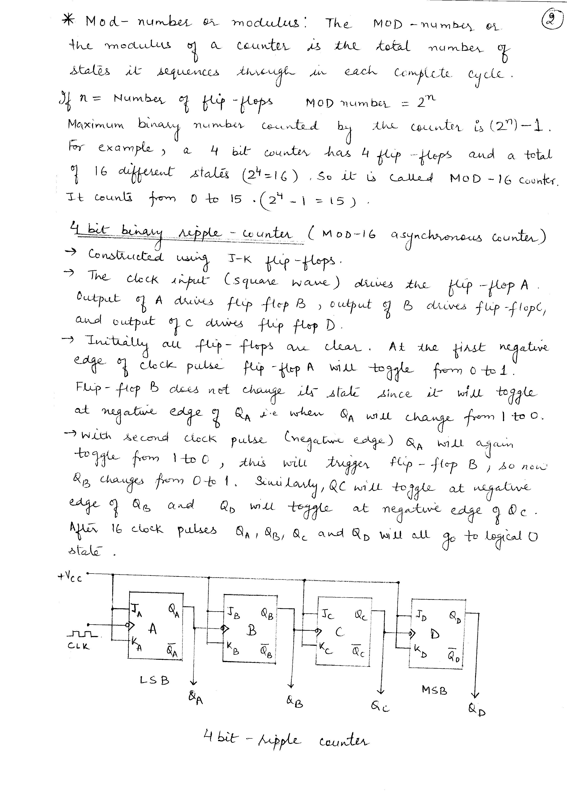
ASYNCHRONOUS UP COUNTER

Slide 7
ASYNCHRONOUS UP COUNTER
A binary ripple counter is constructed using J-K flip-flops.
The system clock drives flip-flop A.
The output of A drives flip-flop B, the output of B drives flip-flop C and the output of C drives flip-flop D.
The overall propagation delay time of the counter is the sum of the individual delays of the flip-flops.
All the J and K inputs are connected to 1, which means that each flip-flop toggles on the negative edge of its clock input.

Slide 8
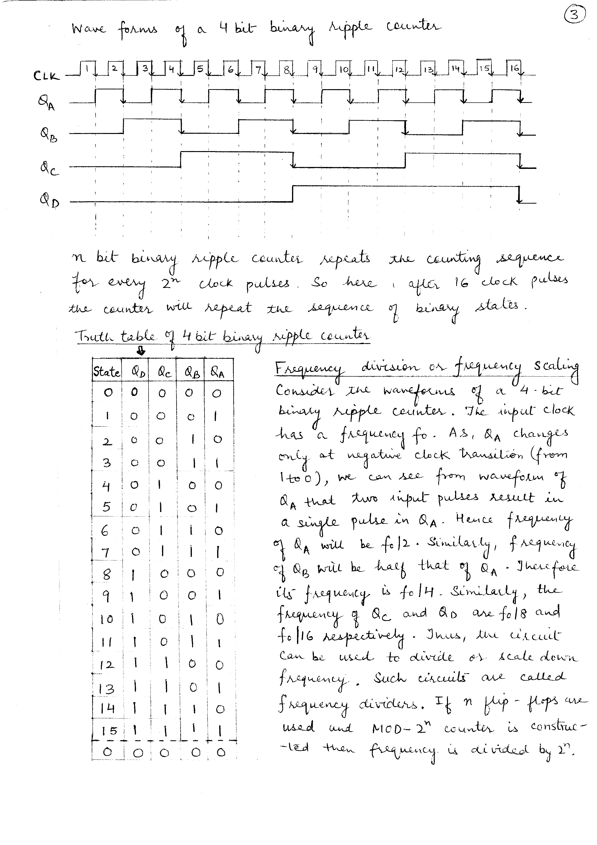
TRUTH TABLE

Slide 9
ASYNCHRONOUS UP COUNTER
Consider initially all flip-flops to be in the logical 0 state.
A negative transition in the clock input which drives flip-flop A causes Q_{A} to change from logical 0 to logical 1.
Flip-flop B does not change its state since it also requires negative transition at its clock input.
With the arrival of second clock pulse to flip-flop A Q_{A} goes from 1 to 0.
This change of state creates the negative going edge needed to trigger flip-flop B and thus Q_{B} goes from 0 to 1.

Slide 10
ASYNCHRONOUS DOWN COUNTER
The 4-bit ripple counter that we discussed earlier it UP counter because it counts from 0 to 15.
A DOWN counter counts downward from maximum count to zero.
n-bit counter will count from 2^{n} – 1 to 0.
In a down counter clock input is applied to clock of the first flip-flop A.

Slide 11
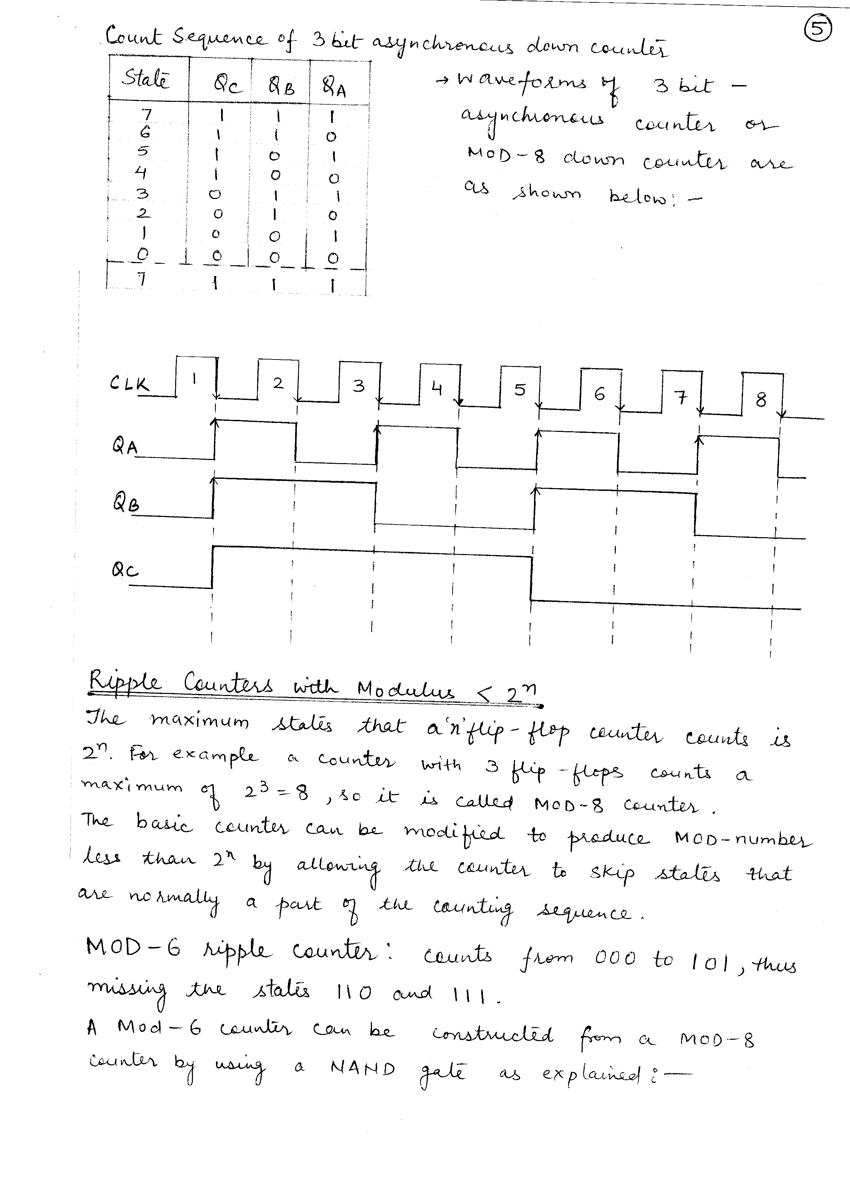
TRUTH TABLE

Slide 12
ASYNCHRONOUS DOWN COUNTER
In a down counter clock input is applied to clock of the first flip-flop A.
The truth table shows that the output Q_{A} changes its state at each negative transition of the clock as it does in UP counter.
The Q_{B} output changes state every time Q_{A} goes from LOW to HIGH.
Q_{C} changes state each time Q_{B} goes from LOW TO HIGH.

Slide 13
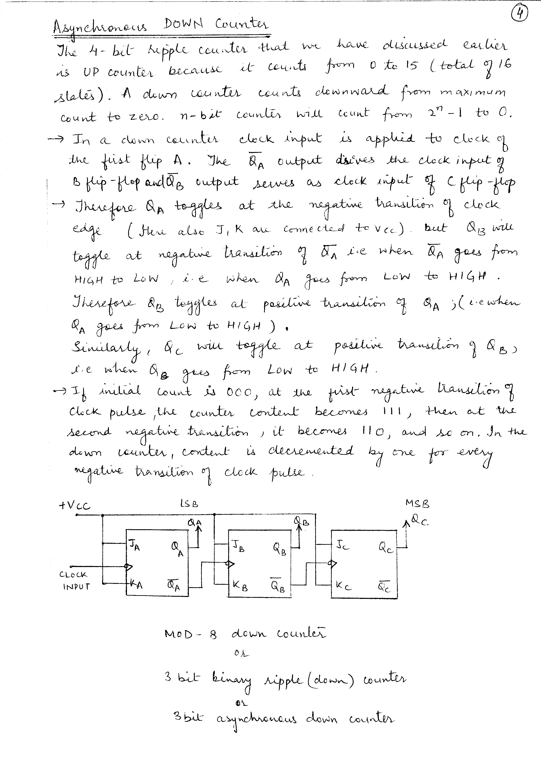
ASYNCHRONOUS DOWN COUNTER

Slide 14
RIPPLE COUNTERS WITH MODULUS < 2^{n}
The maximum states that a ‘n’ flip-flop counter counts is 2^{n}
For example a counter with 3 flip-flops counts a maximum of 2³=8, so it is called MOD-8 counter.
The basic counter can be modified to produce MOD-number less than 2^{n} by allowing the counter to skip states that are normally a part of the counting process.

Slide 15
MOD-6 RIPPLE COUNTER
Counts from 000 to 101 thus missing the states 110 and 111.
A MOD-6 counter can be constructed from a MOD-8 counter by using a NAND gate.

Slide 16
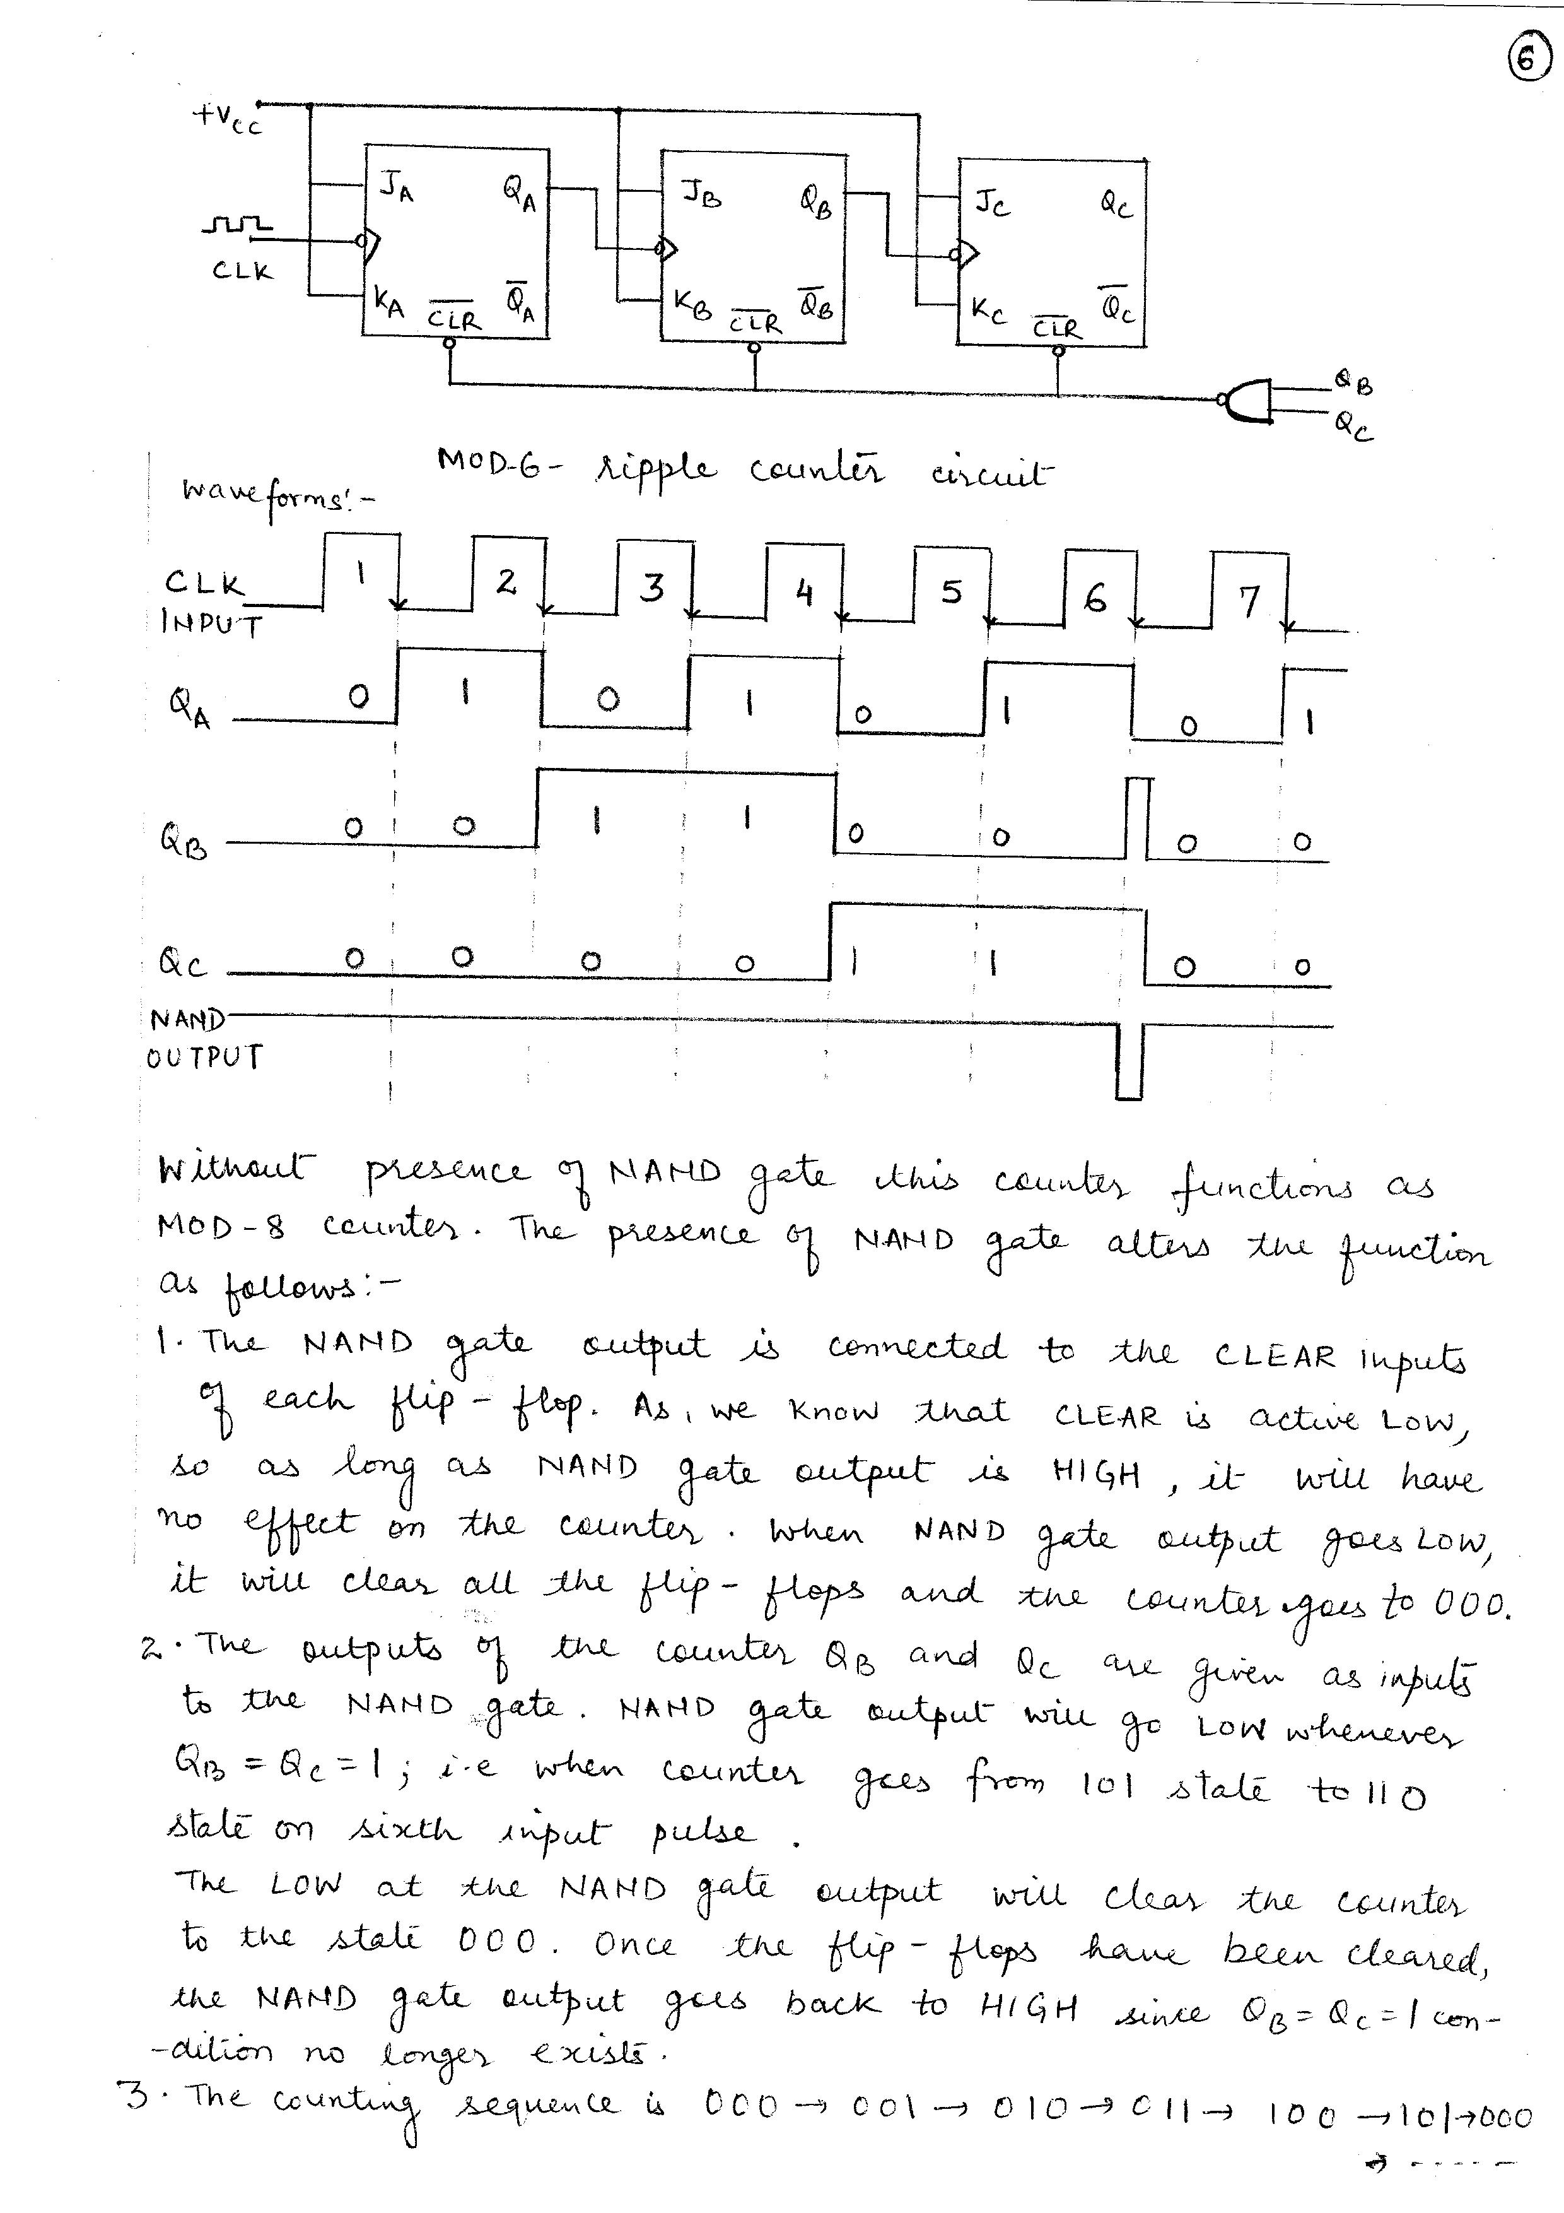
MOD-6 RIPPLE COUNTER

Slide 17
MOD-6 RIPPLE COUNTER
Without the NAND gate, this counter functions as a MOD-8 binary counter, which counts from 000 – 111.
However the presence of NAND gate, alters the sequence.
The NAND gate output is connected to the CLEAR inputs of each flip-flop.
As long as the NAND gate output is HIGH, it will have no effect on the counter.
When the NAND gate output goes LOW, it will clear all flip-flops, and the counter immediately goes to the 000 state.

Slide 18
MOD-6 RIPPLE COUNTER
The outputs of the counter Q_{B} and Q_{C} are given as inputs to the NAND gate.
The NAND gate output goes LOW whenever Q_{B} = Q_{C} =1.
This condition will occur when the counter goes from 101 to 110 state.
The LOW at the NAND gate output will clear the counter to the 000 state.
Once the flip-flops have been cleared, the NAND gate output goes back to HIGH, since Q_{B} = Q_{C} =1.

Slide 19
UP-DOWN ASYNCHRONOUS COUNTER
It is a combination of up-counter and down-counter.
As the UP-DOWN counter has the capability of counting upwards as well as downwards, it is also called Multimode Counter.
In an UP counter, each flip-flop is triggered by the normal output of the preceding flip-flop.
In a DOWN counter, each flip-flop is triggered by the inverted output of the preceding flip-flop.
In both the counters, the first flip-flop is triggered by the input pulses.
A 4-bit UP-DOWN Counter operation is controlled by the UP and DOWN control inputs.

Slide 20
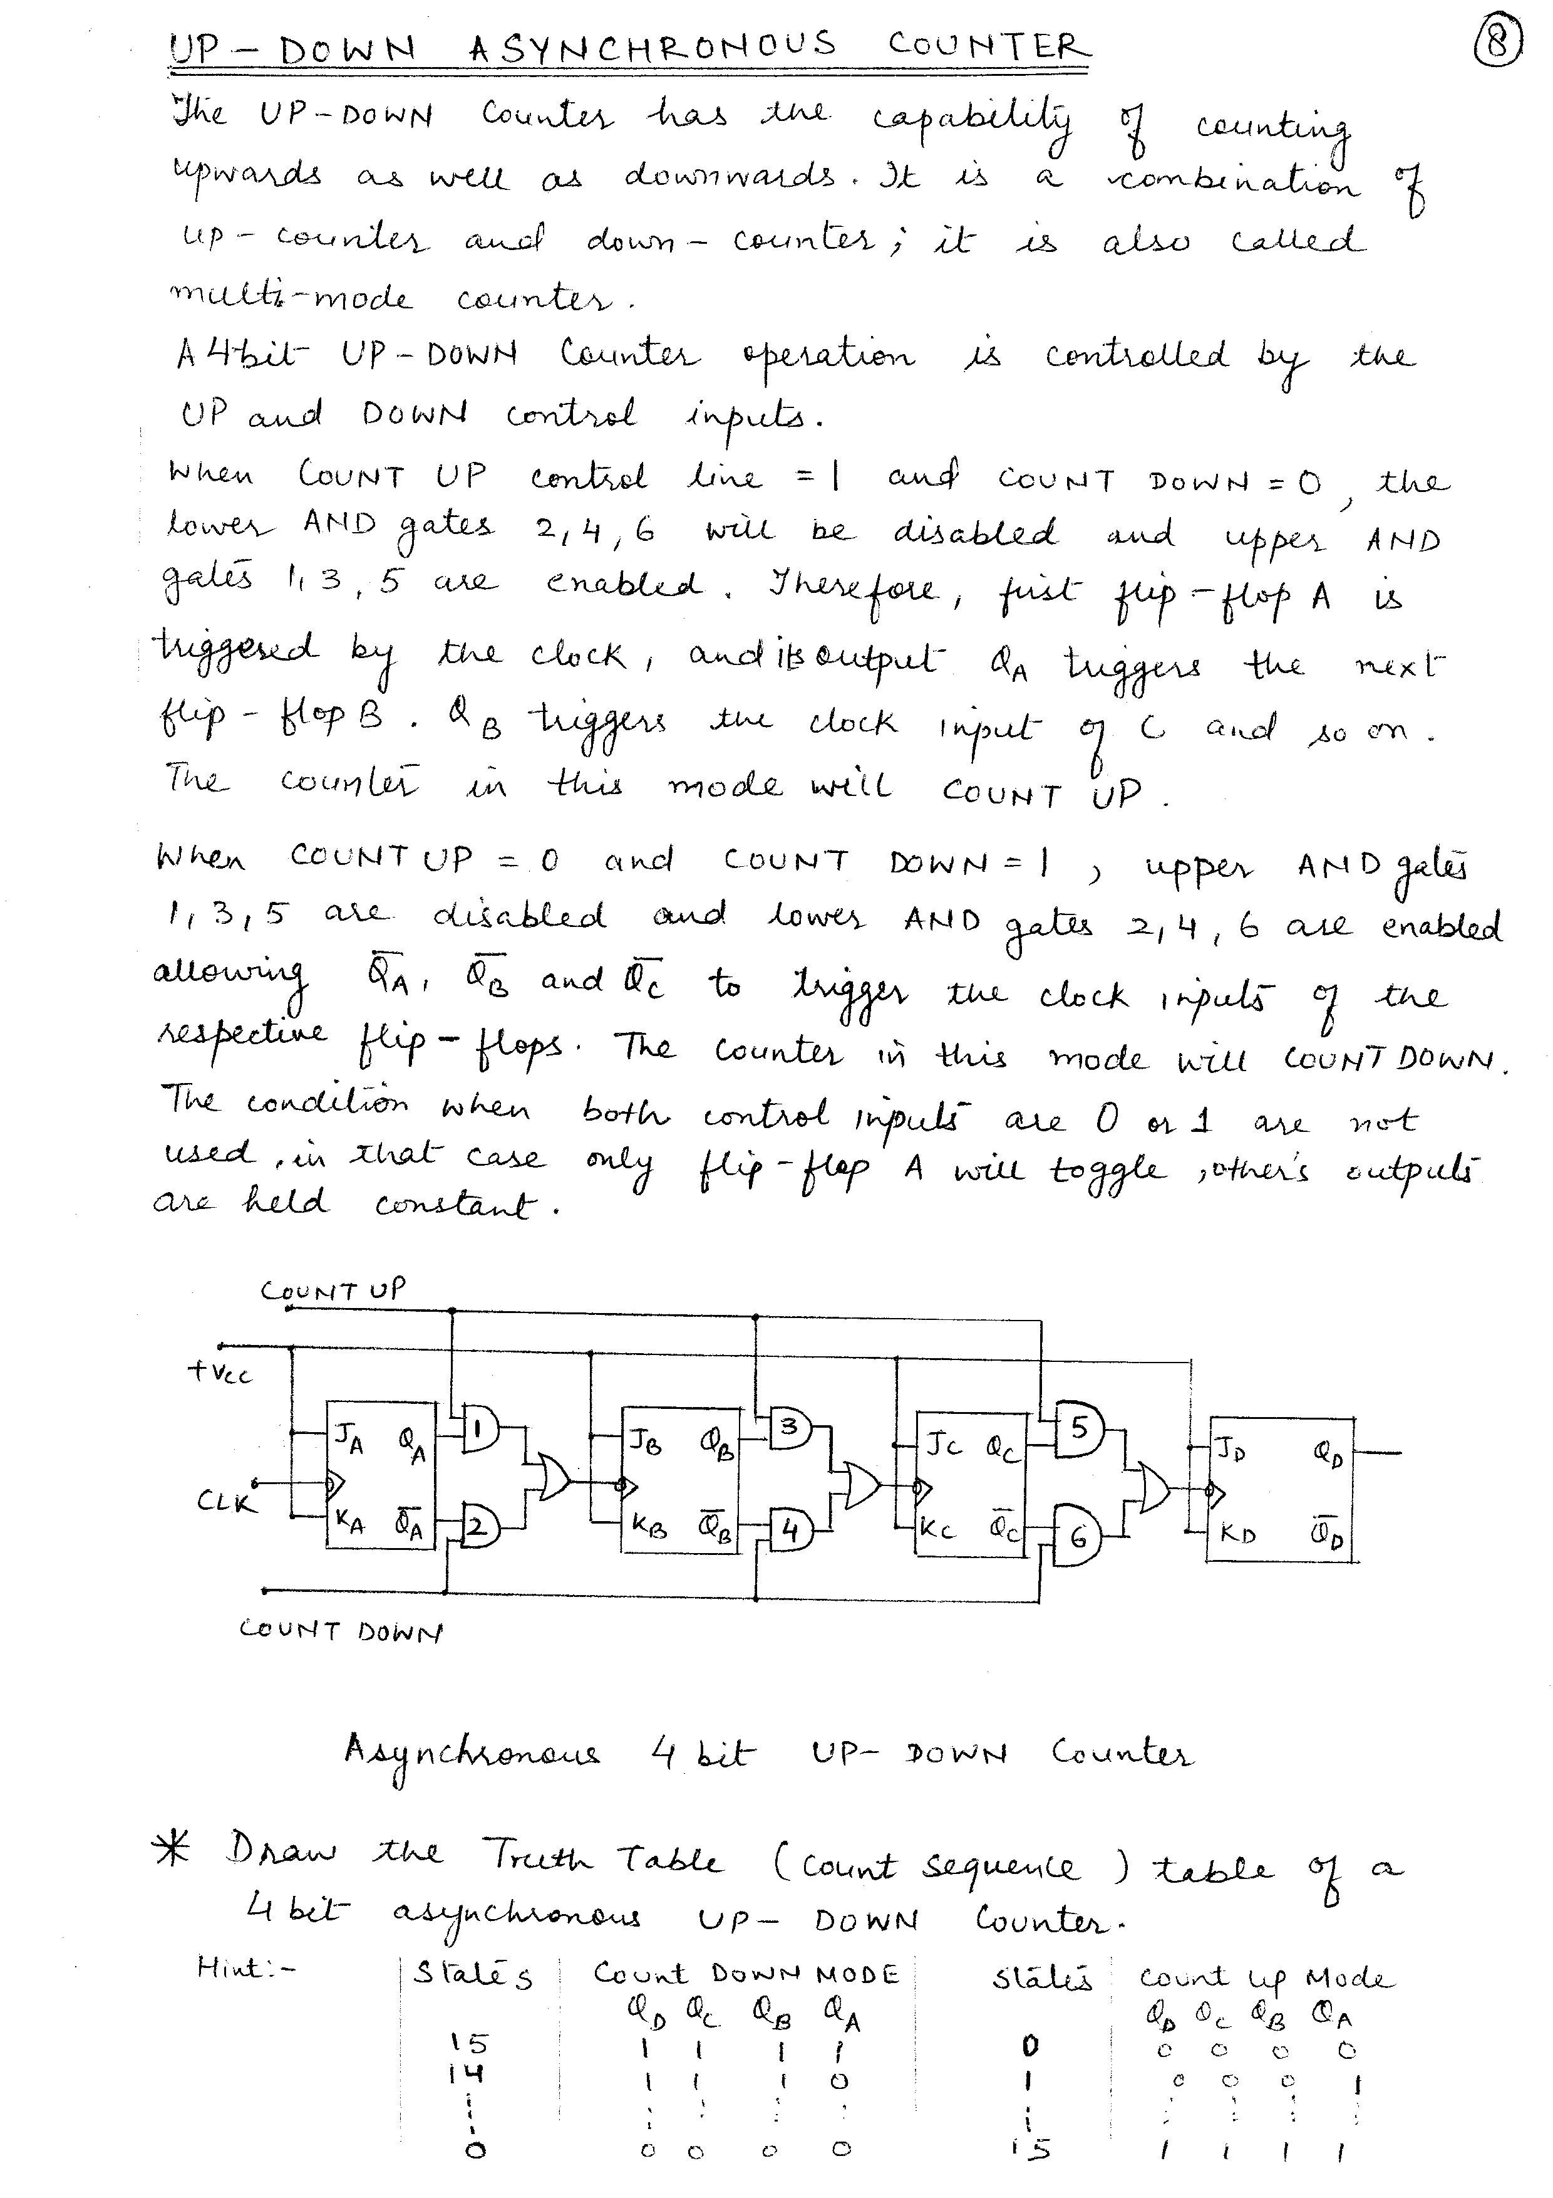
UP-DOWN ASYNCHRONOUS COUNTER

Slide 21
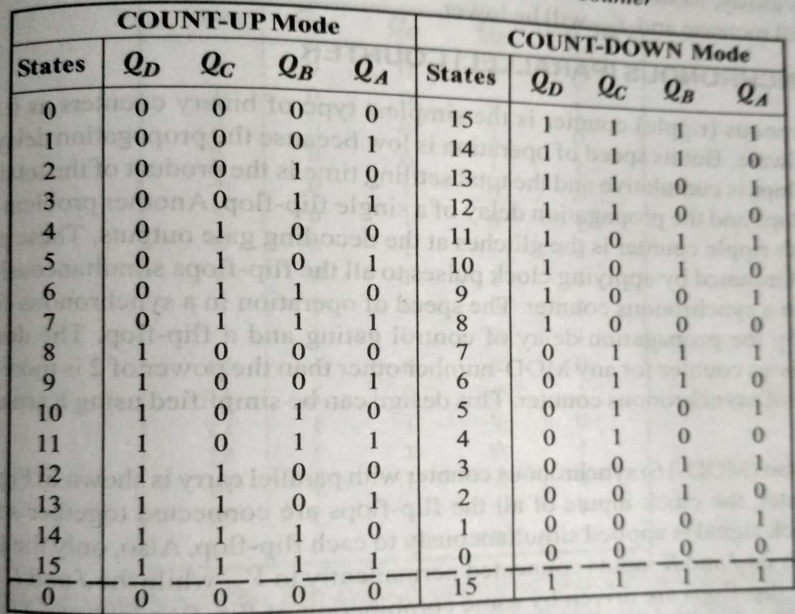
TRUTH TABLE

Slide 22
UP-DOWN ASYNCHRONOUS COUNTER
When count up line =1 and count down=0, the lower AND gates 2,4,6 will be disabled and upper AND gates 1, 3, 5 are enabled.
Therefore first flip-flop A is triggered by the clock and its output Q_{A} triggers the next flip-flop B.
Q_{B} triggers the clock input of C and so on.
The counter in this mode will COUNT UP.

Slide 23
UP-DOWN ASYNCHRONOUS COUNTER
When count up=0 and count down=1, upper AND gates 1,3,5 are disabled and lower AND gates 2,4,6 are enabled allowing Q_{A}’, Q_{B}’ and Q_{C}’ to trigger the clock inputs of the respective flip-flops.
The counter in this mode will COUNT DOWN.

Slide 24
SYNCHRONOUS UP COUNTERS
Speed of operation of asynchronous counters is low because of cumulative propagation delay time.
This can be eliminated by applying clock pulses to all the flip-flops simultaneously, which is done in synchronous counters.
However synchronous counter has more complex circuitry than an asynchronous counter.

Slide 25
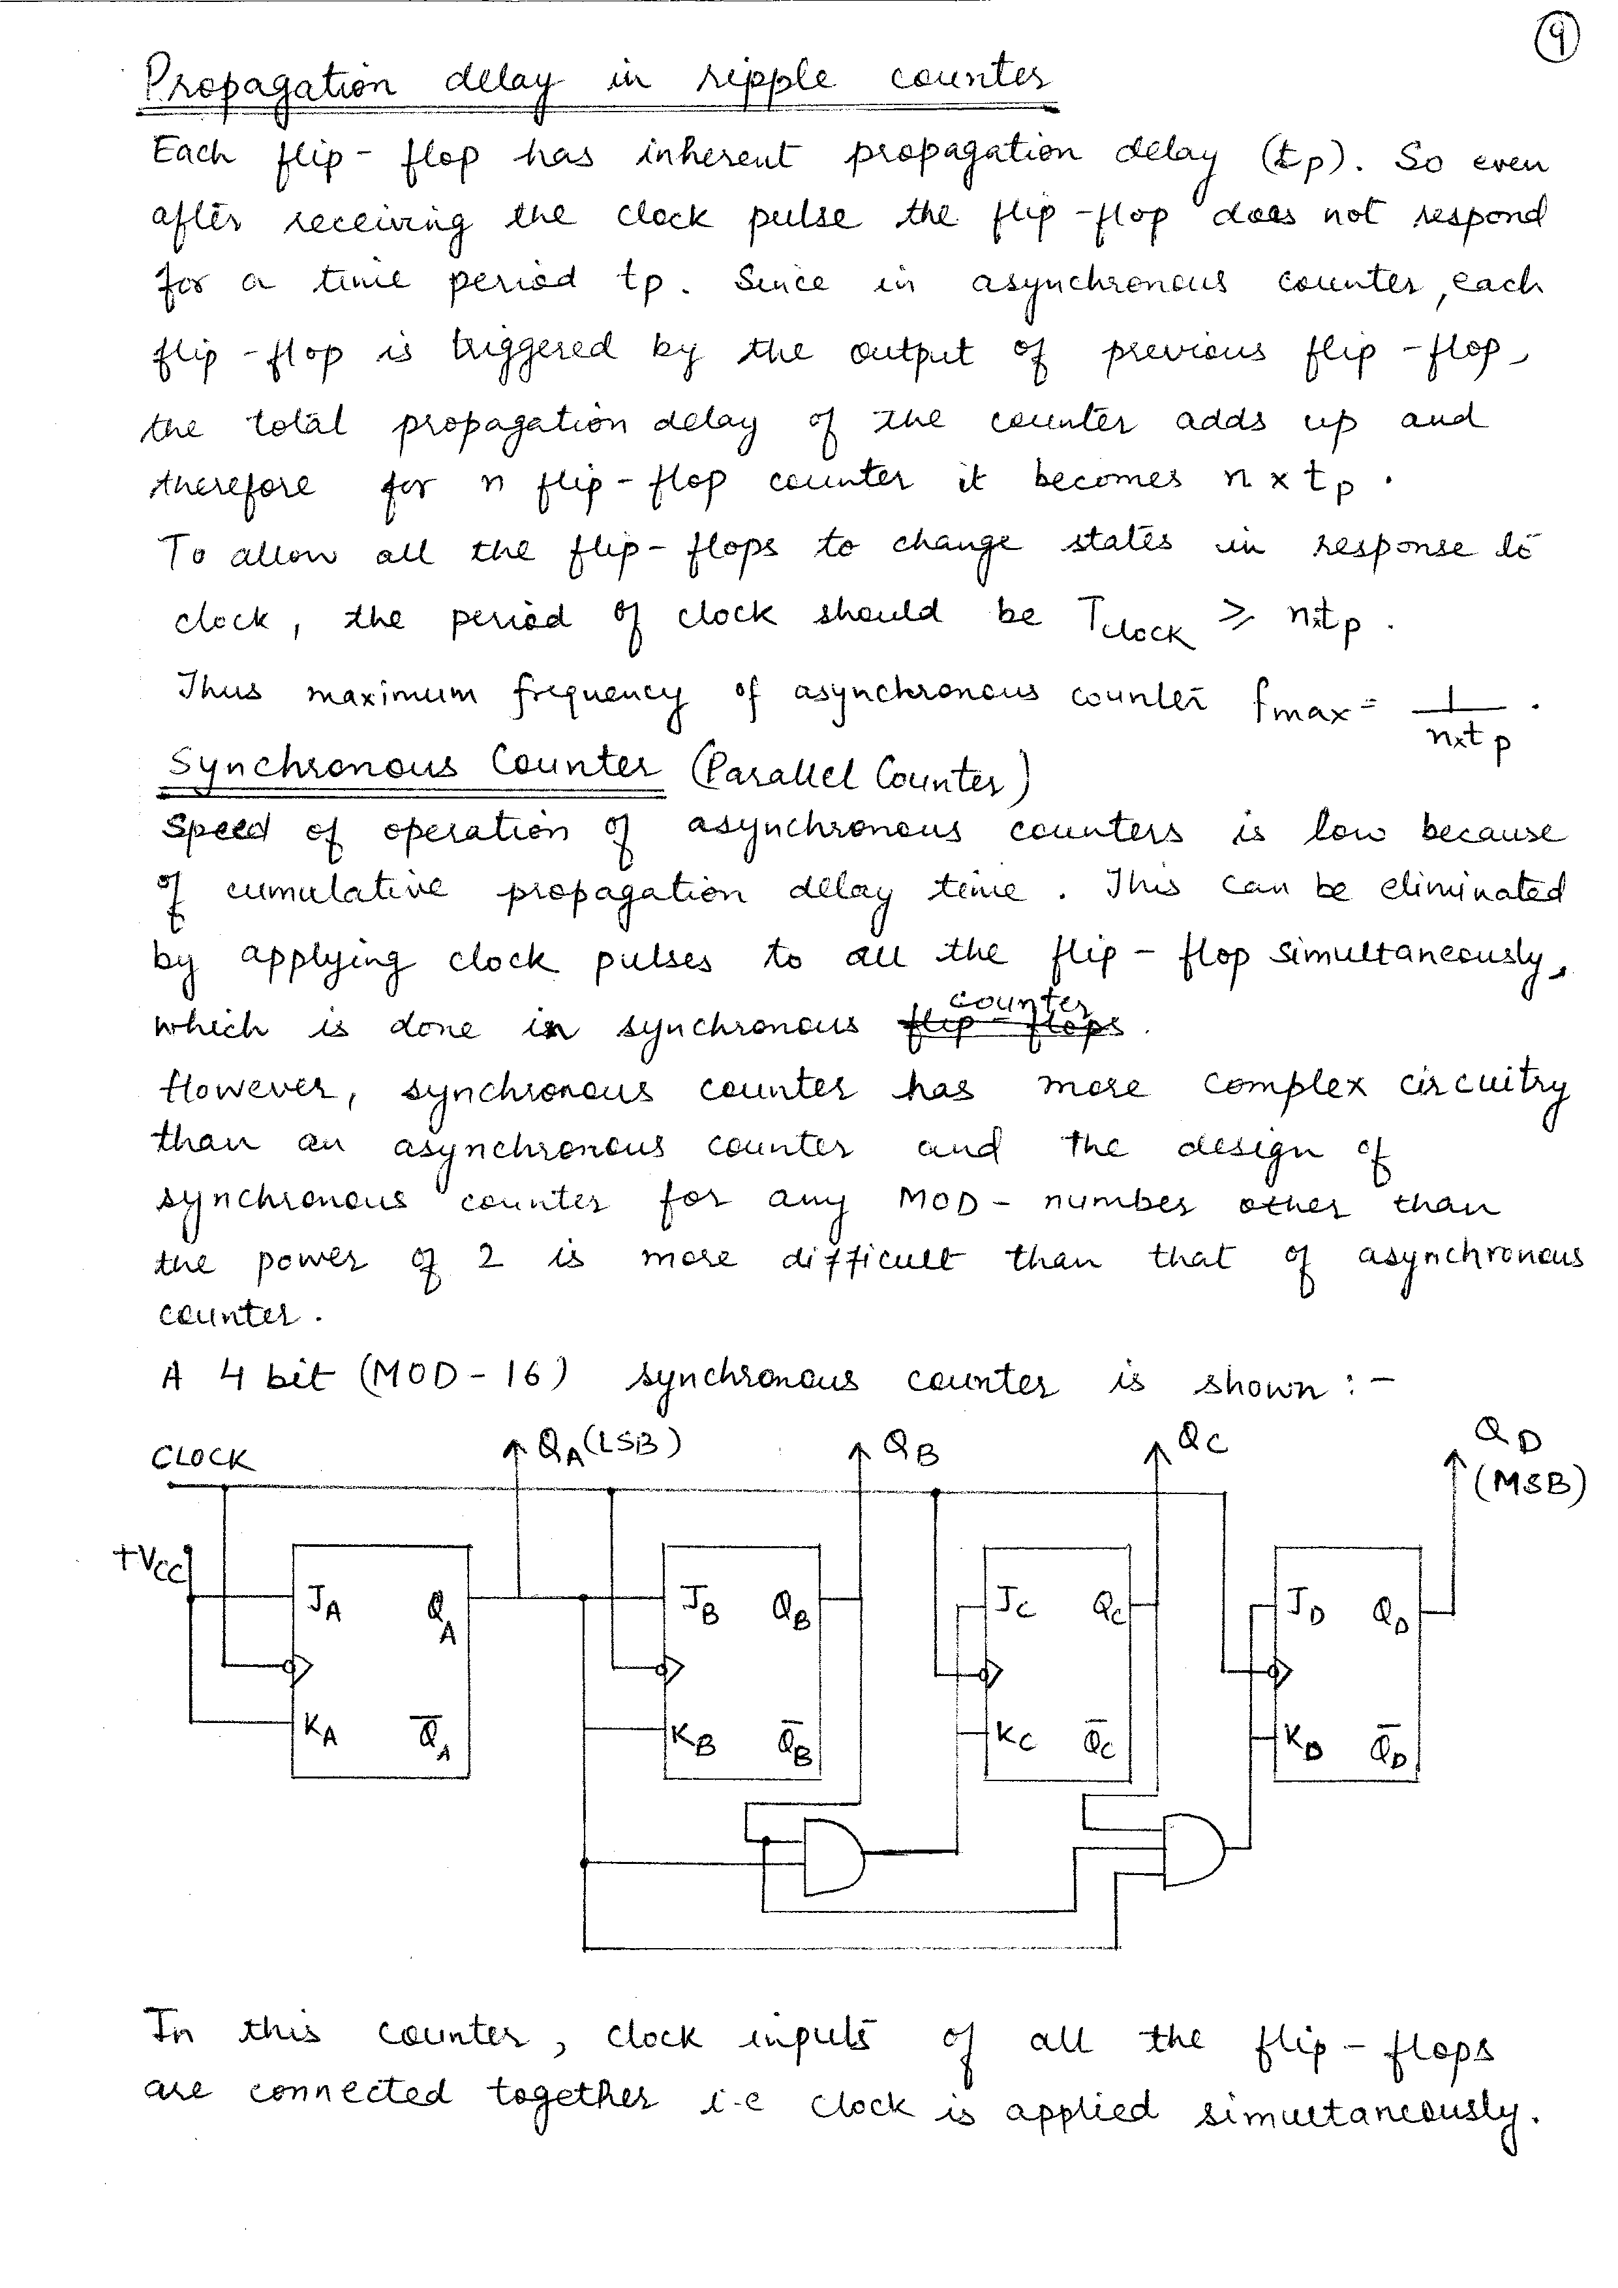
SYNCHRONOUS UP COUNTERS

Slide 26
SYNCHRONOUS UP COUNTERS
In this counter, clock inputs of all the flip-flops are connected together i.e. clock is applied simultaneously.
Only the LSB flip-flop A ahs its J and K inputs connected to 1.
J and K inputs of flip-flop B are connected with Q_{A}.
Flip-flop A changes its state with negative transition at each clock pulse.
Flip-flop B changes its state when Q_{A} =1 and when there is negative transition at clock input.
Since J and K inputs of flip-flop C are connected to the AND operated output of Q_{A} and Q_{B} so flip-flop C changes its state when Q_{A} = Q_{B}=1 and negative transition of clock.
Similarly QD changes its state when Q_{A} = Q_{B}= Q_{C}=1 and negative transition of clock.

Slide 27
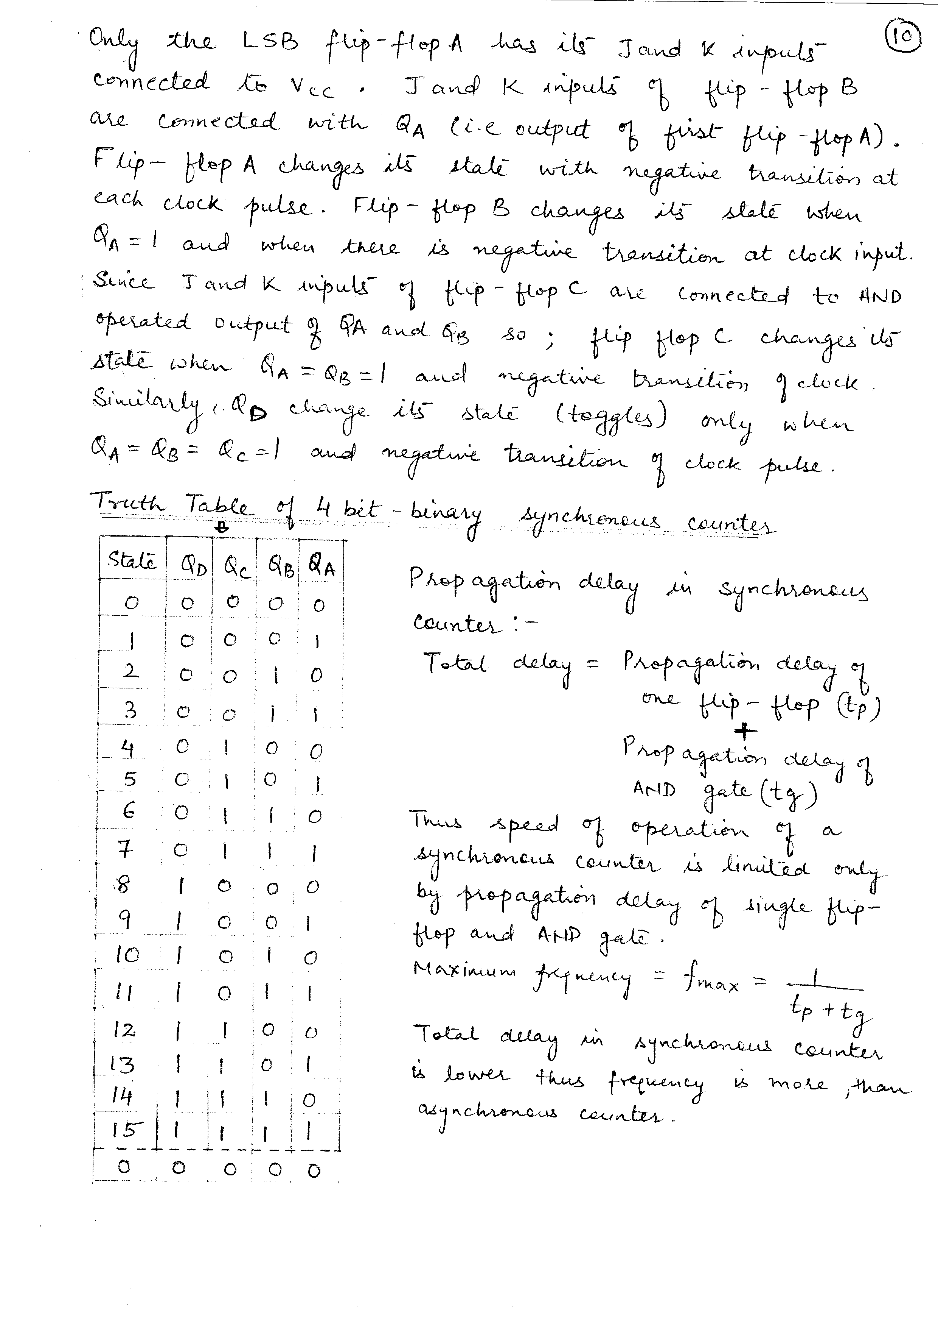
SYNCHRONOUS UP COUNTERS

Slide 28
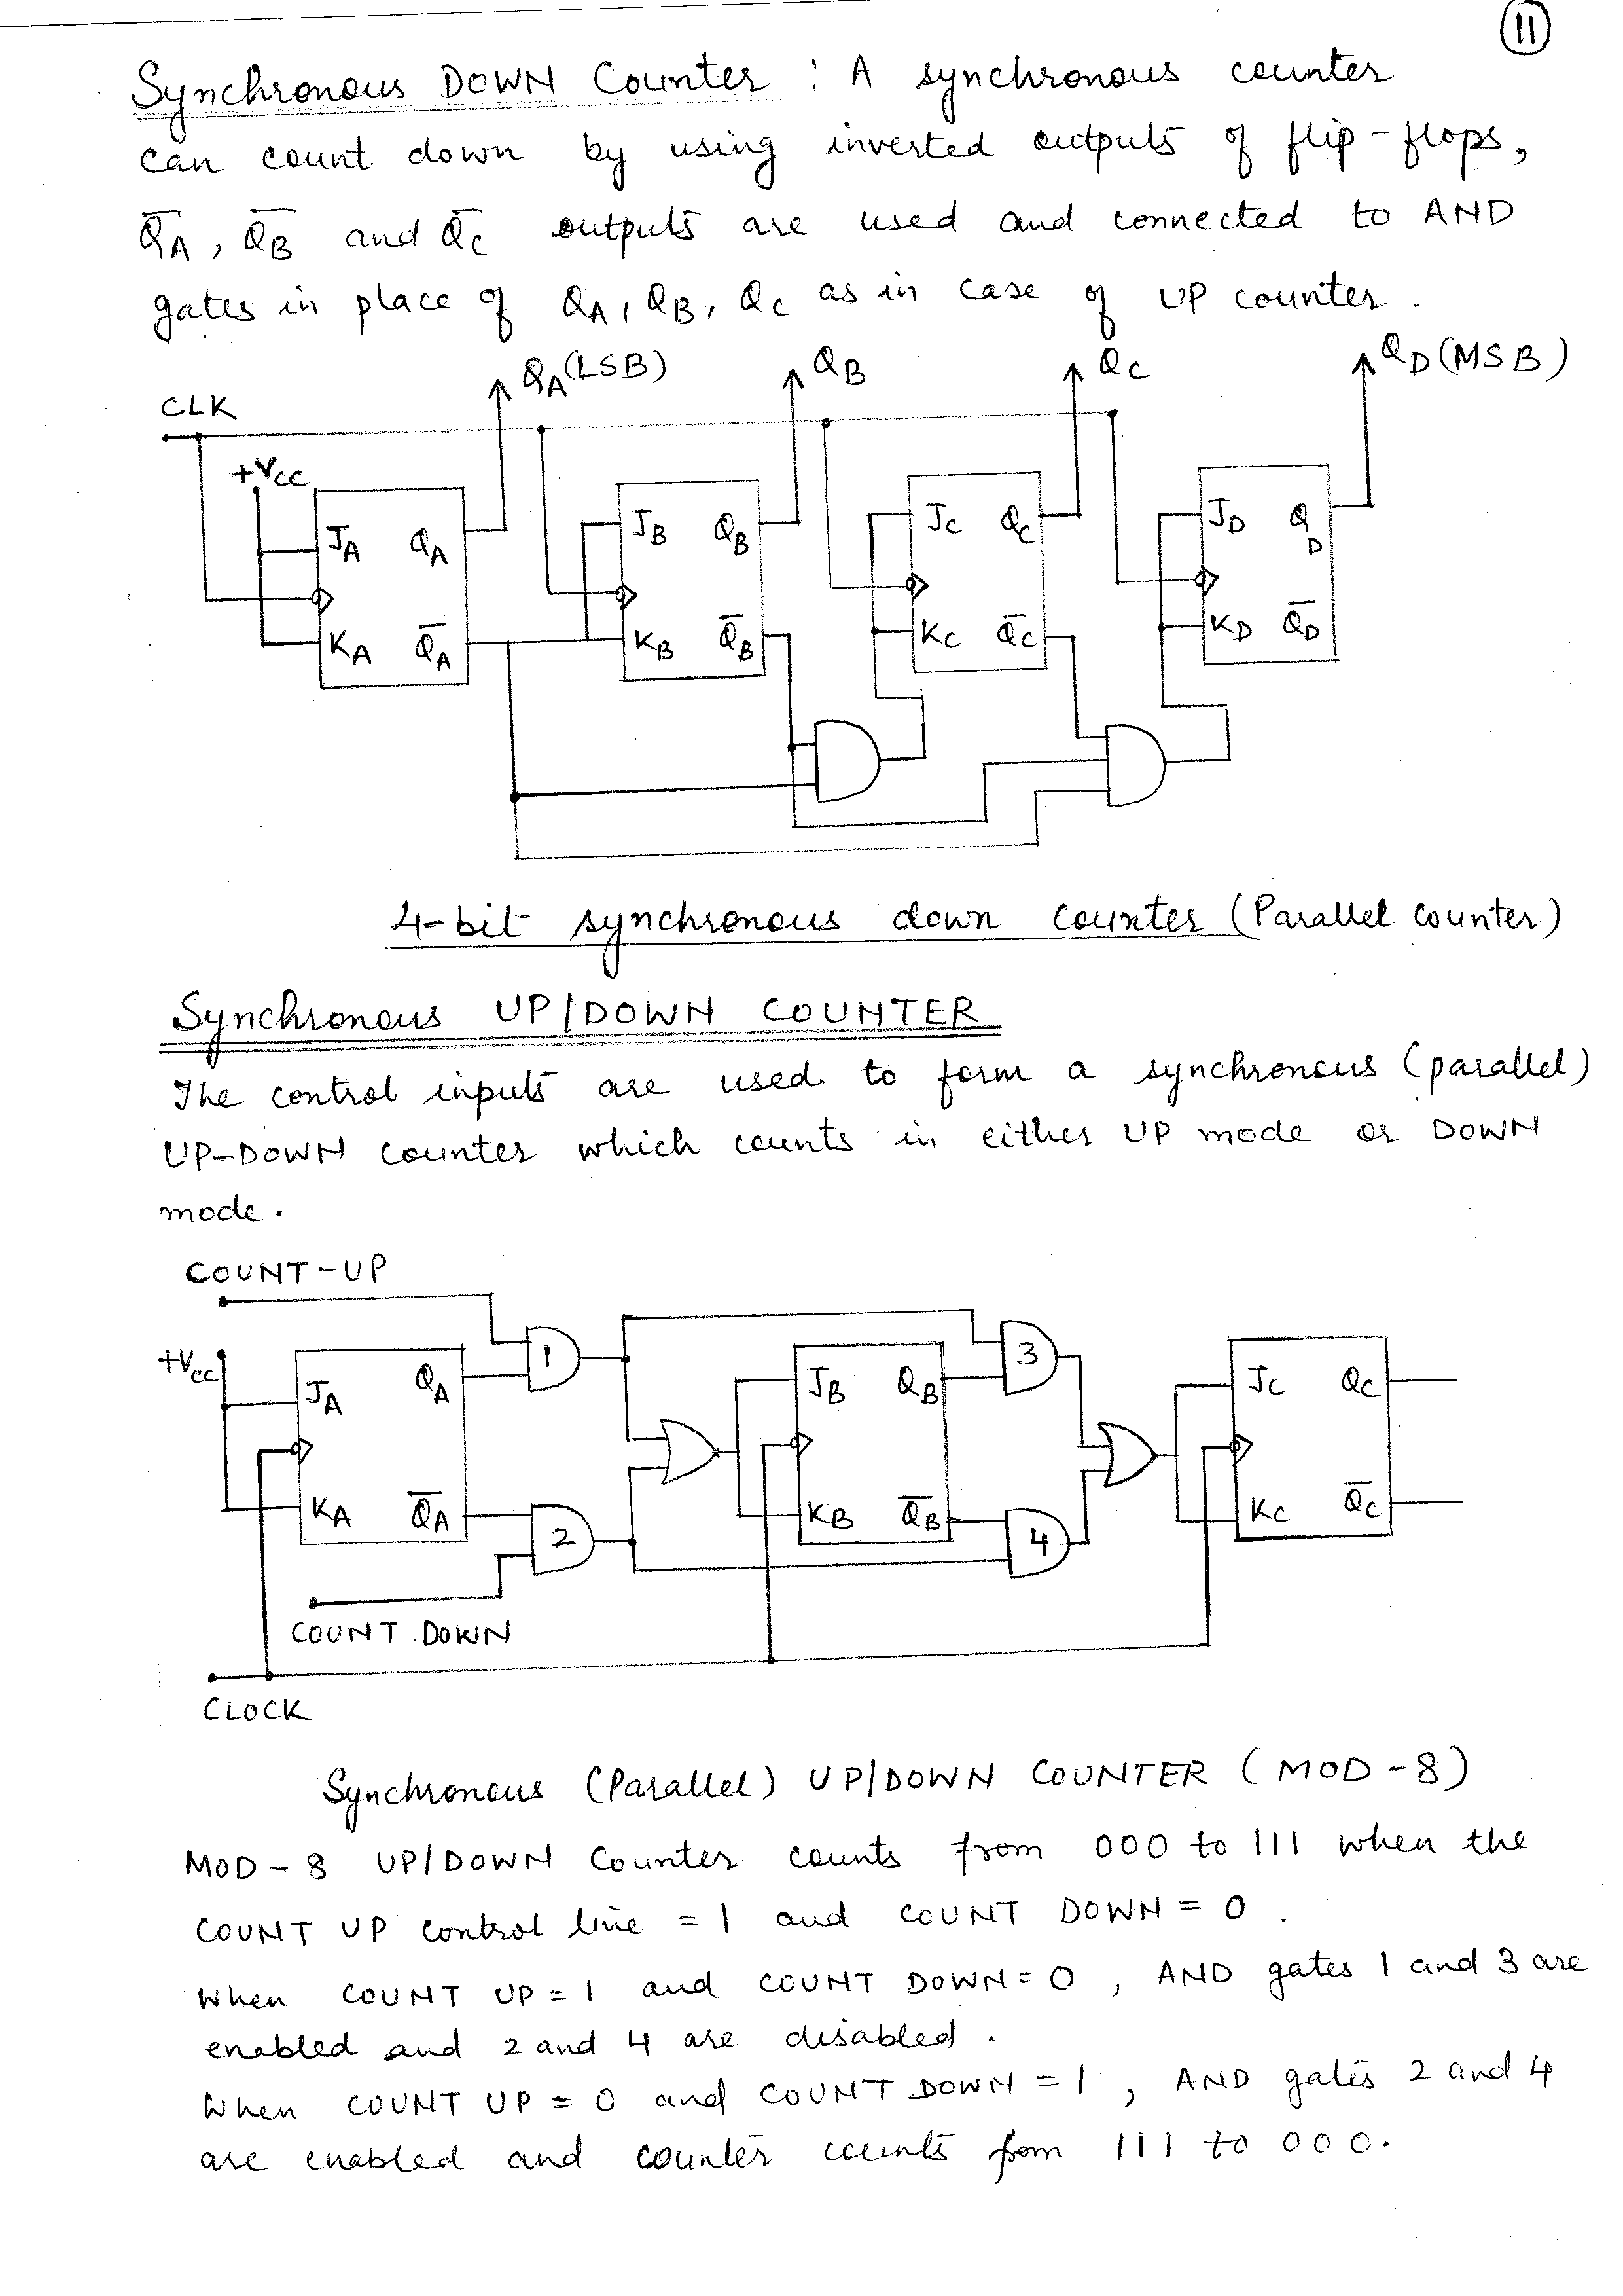
SYNCHRONOUS DOWN COUNTER
A parallel down counter can be made to count down by using the inverted outputs of the flip-flops to feed the various logic gates.

Slide 29
SYNCHRONOUS UP/DOWN COUNTER
To form a parallel UP/DOWN counter, the control inputs (COUNT-UP and COUNT-DOWN) are used to allow either the normal output or the inverted output of one flip-flop to the J and K inputs of the flip-flop.
A MOD-8 UP/DOWN counter which will count from 000 to 111 when the COUNT-UP=1 and COUNT-DOWN=0 or from 111 to 000 when the COUNT-DOWN=1 and COUNT-UP=0.

Slide 30
SYNCHRONOUS UP/DOWN COUNTER

Slide 31
RING COUNTER
Shift registers can be arranged to form different types of counters using feedback connections.
In a ring counter, the output Q of the last flip-flop in a shift register is connected to the serial input of the first flip-flop.
Only one flip-flop is SET at any particular time while others are cleared.
The flip-flops are connected in such a way that information shifts either from left to right and back or from right to left and back.
Since a single 1 in the register is made to circulate around the register as long as clock pulses are applied, it is called ring counter.

Slide 32
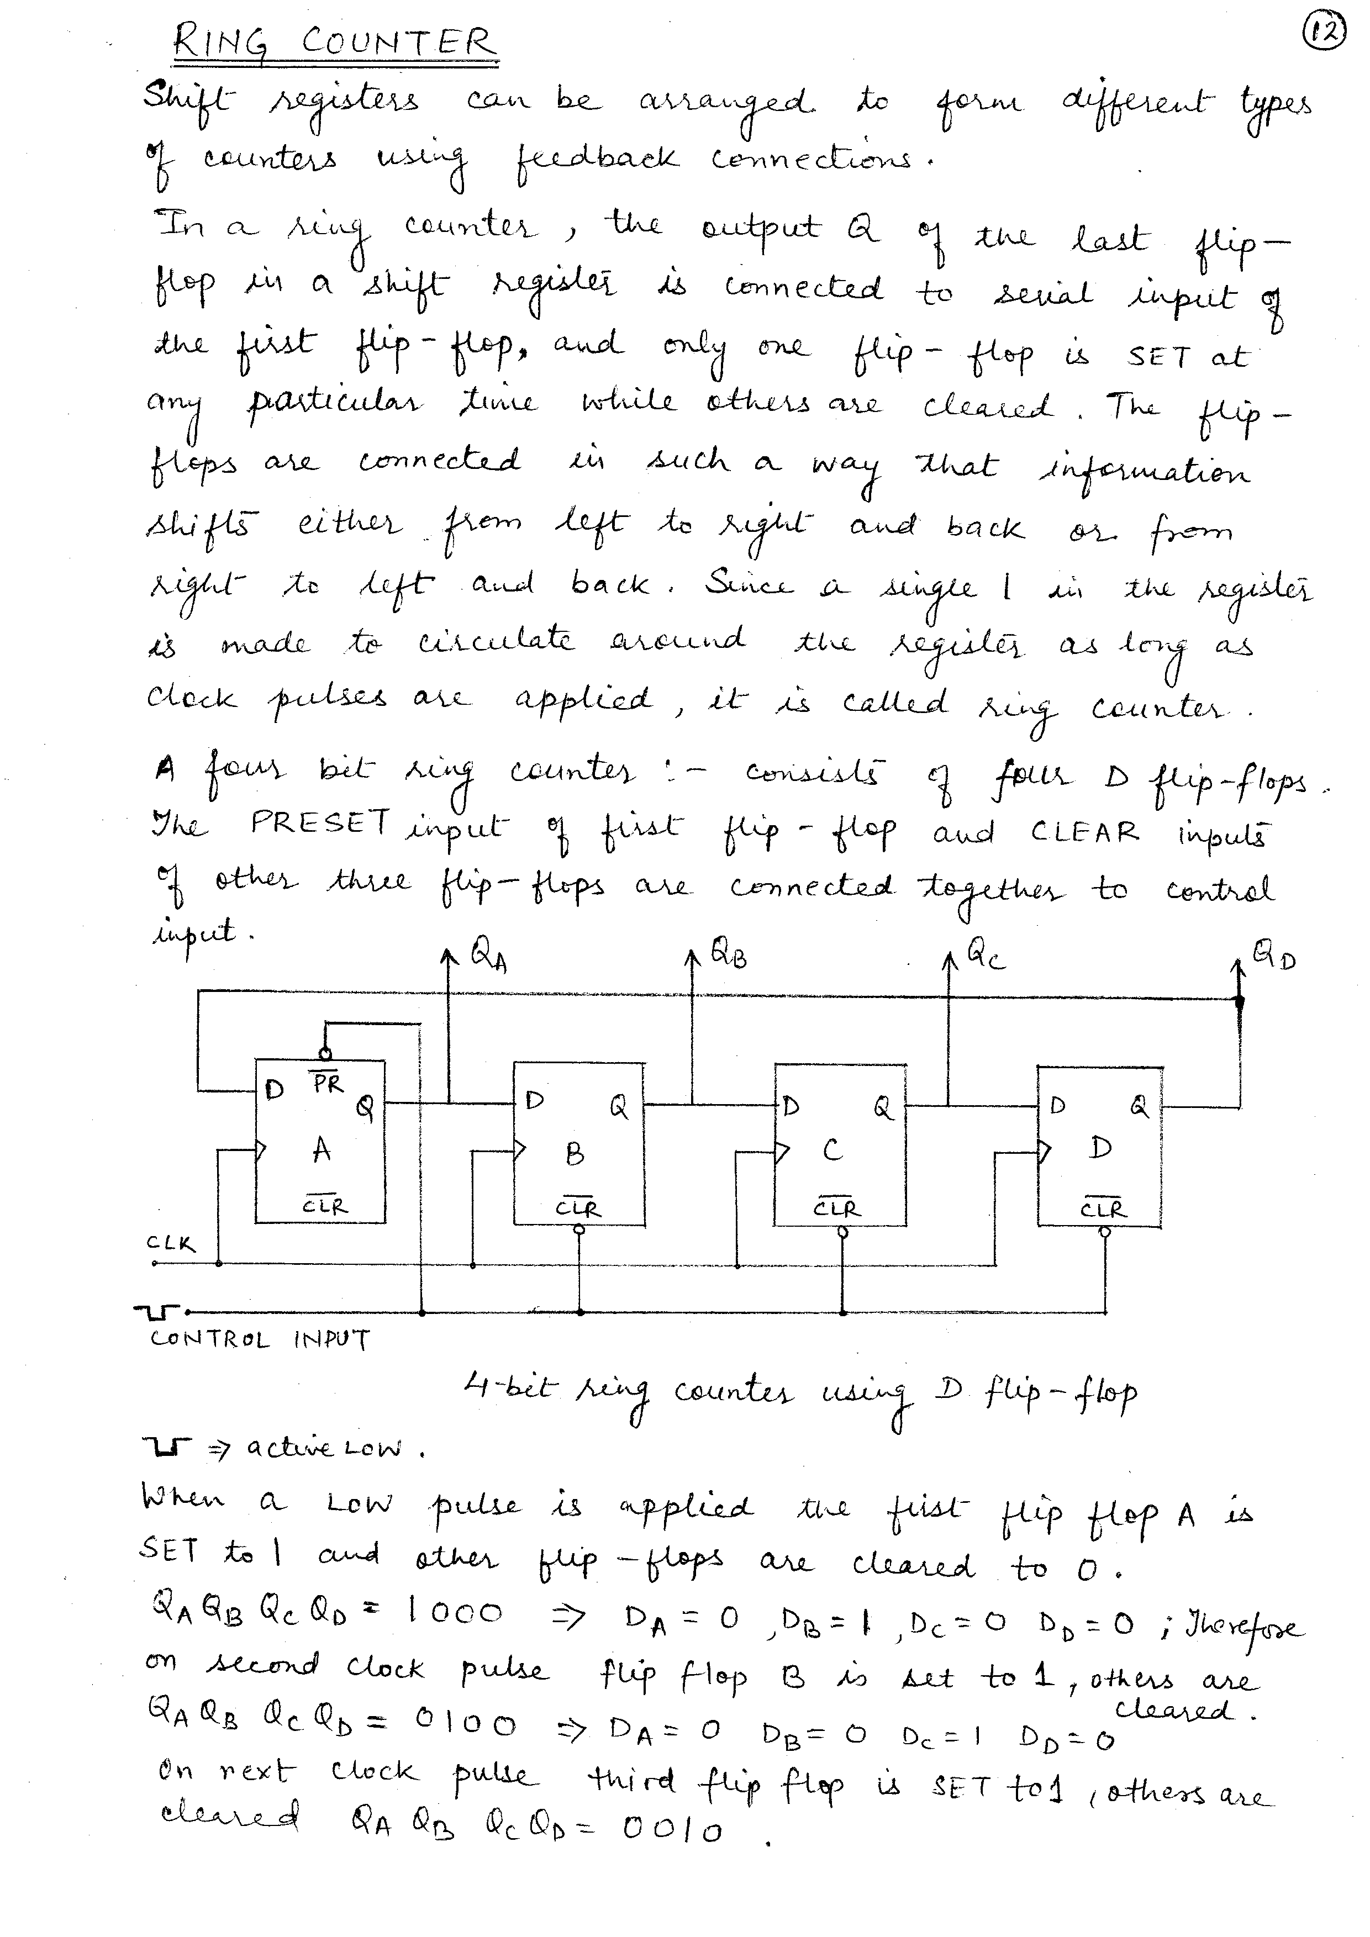
RING COUNTER

Slide 33
RING COUNTER
A four bit ring counter consists of four D flip-flops.
The PRESET input of first flip-flop and CLEAR inputs of other three flip-flops are connected together to control input.
When a low pulse is applied the first flip-flop A is SET to 1 and other flip-flops are cleared to 0.

Slide 34
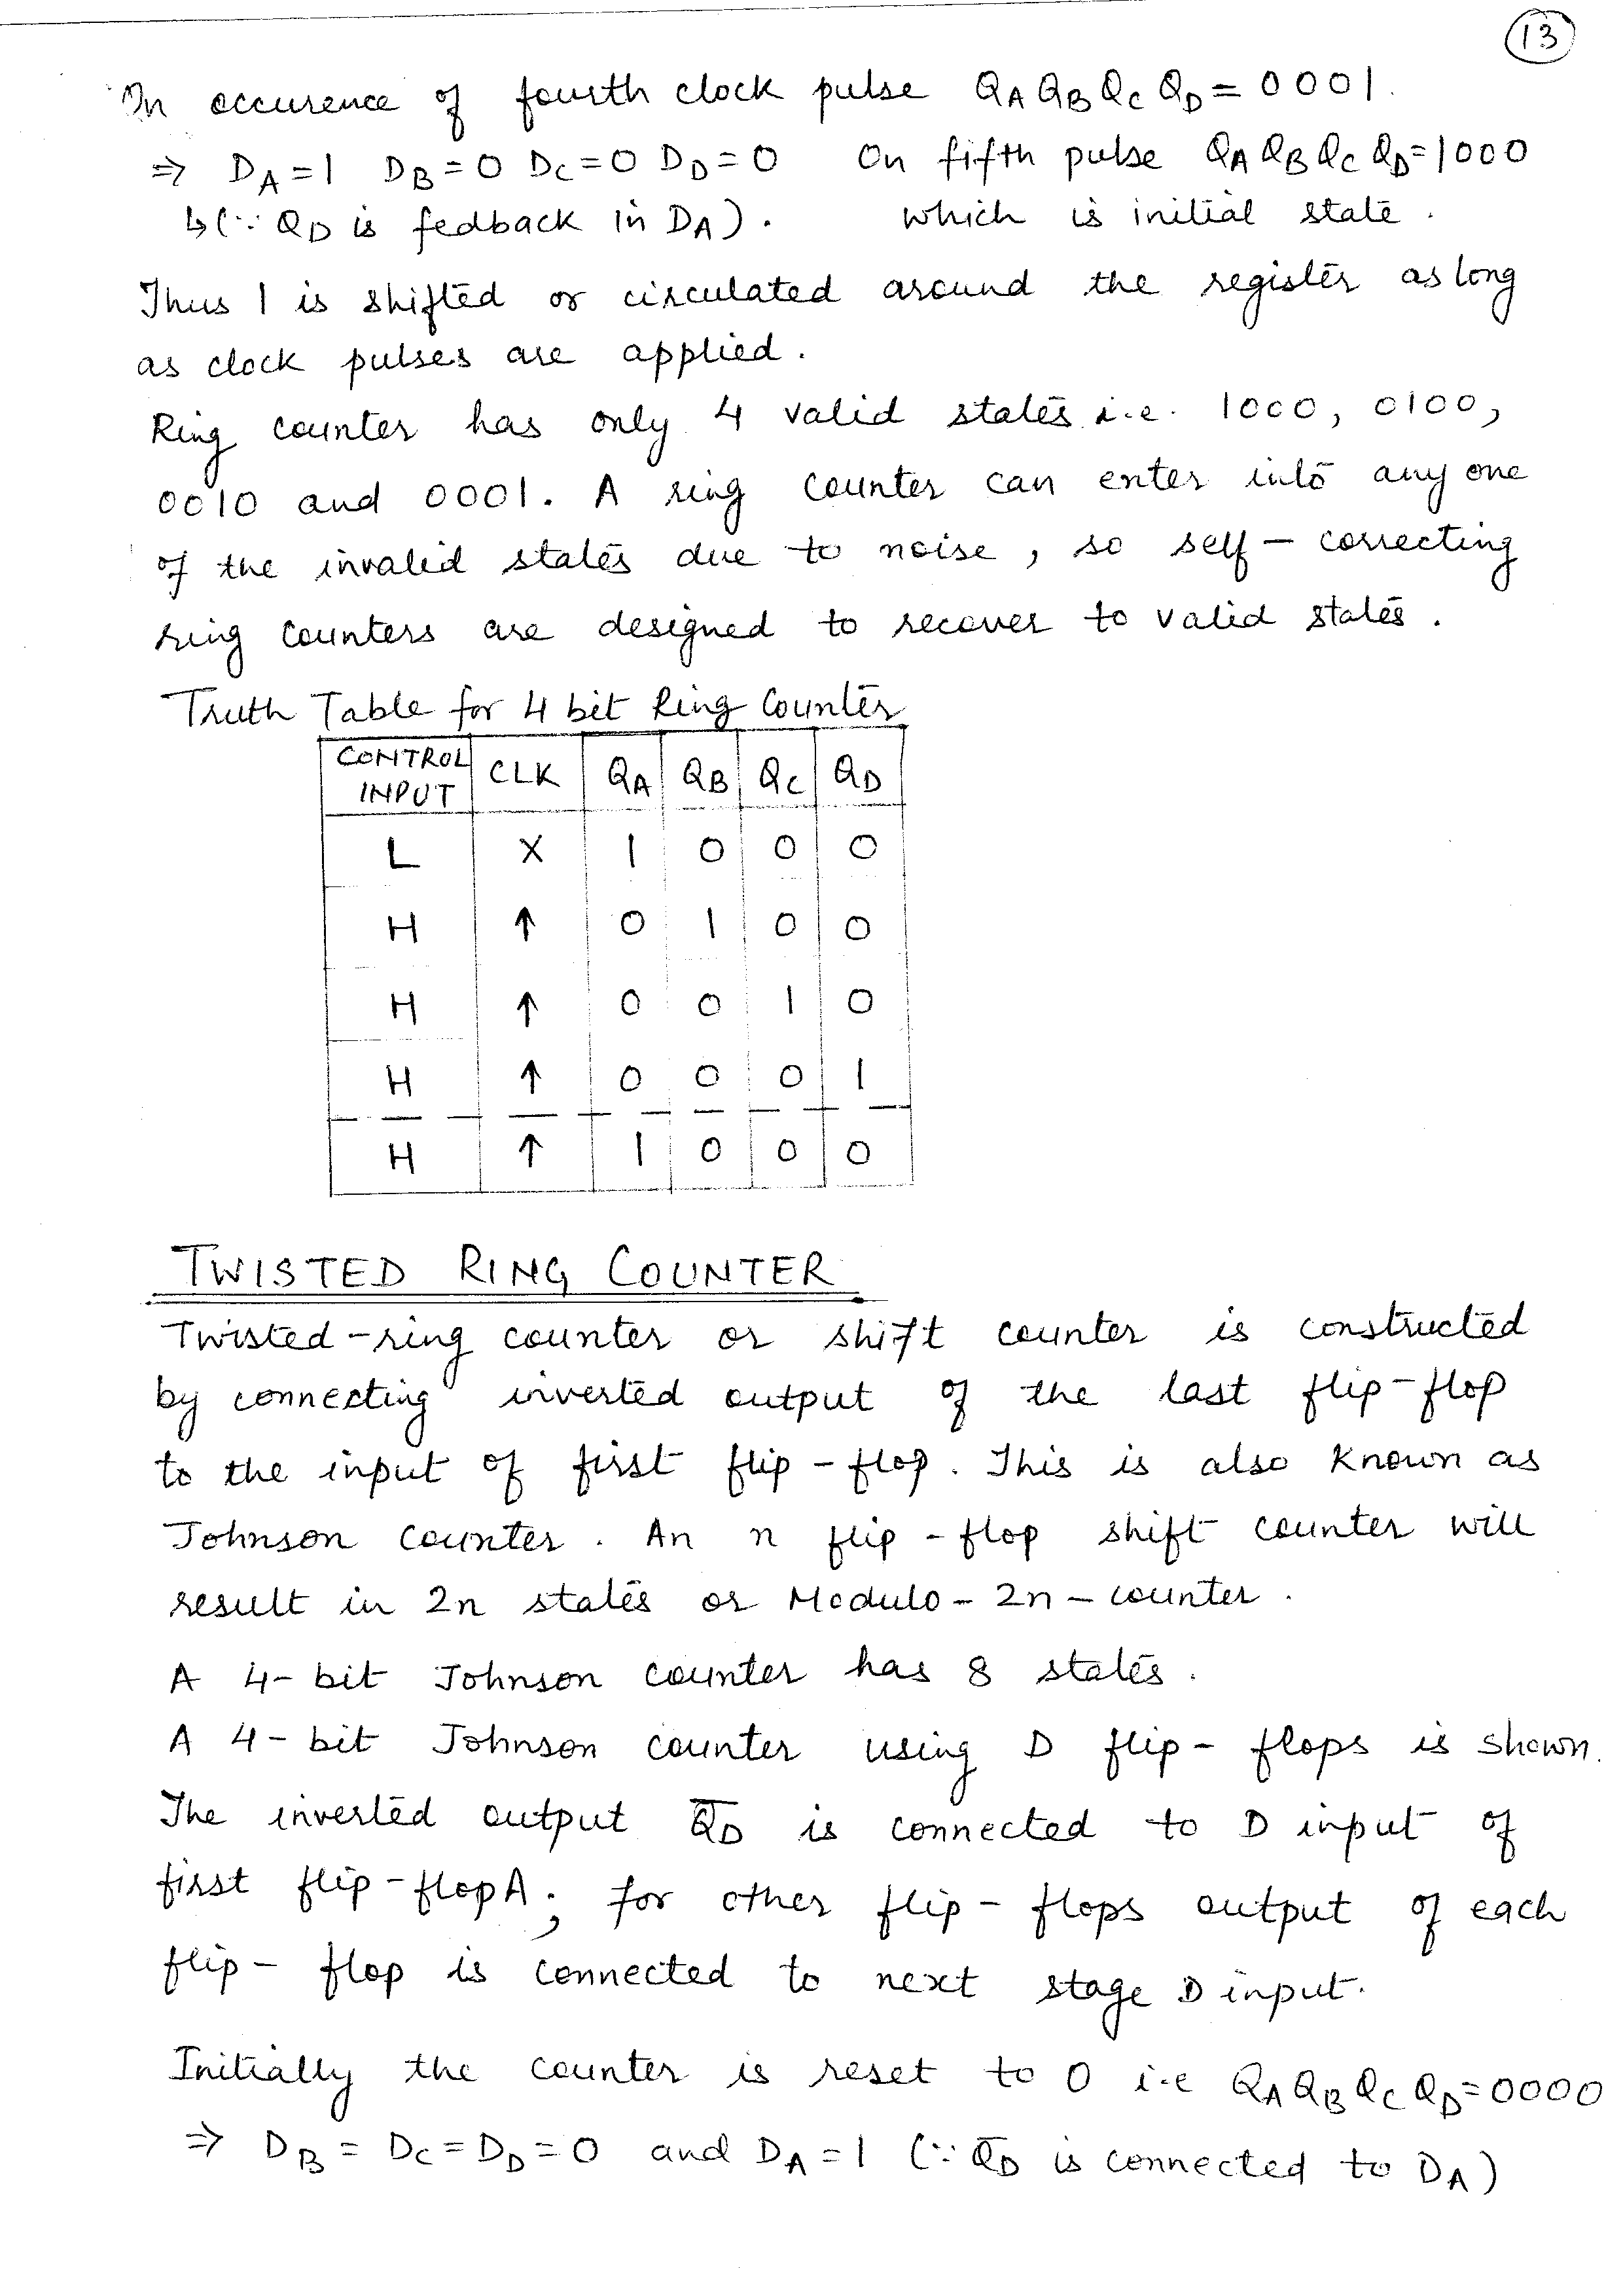
TRUTH TABLE

Slide 35
TWISTED RING COUNTER
It is constructed by connecting inverted output of the last flip-flop to the input of first flip-flop.
This is also known as Johnson Counter.

Slide 36
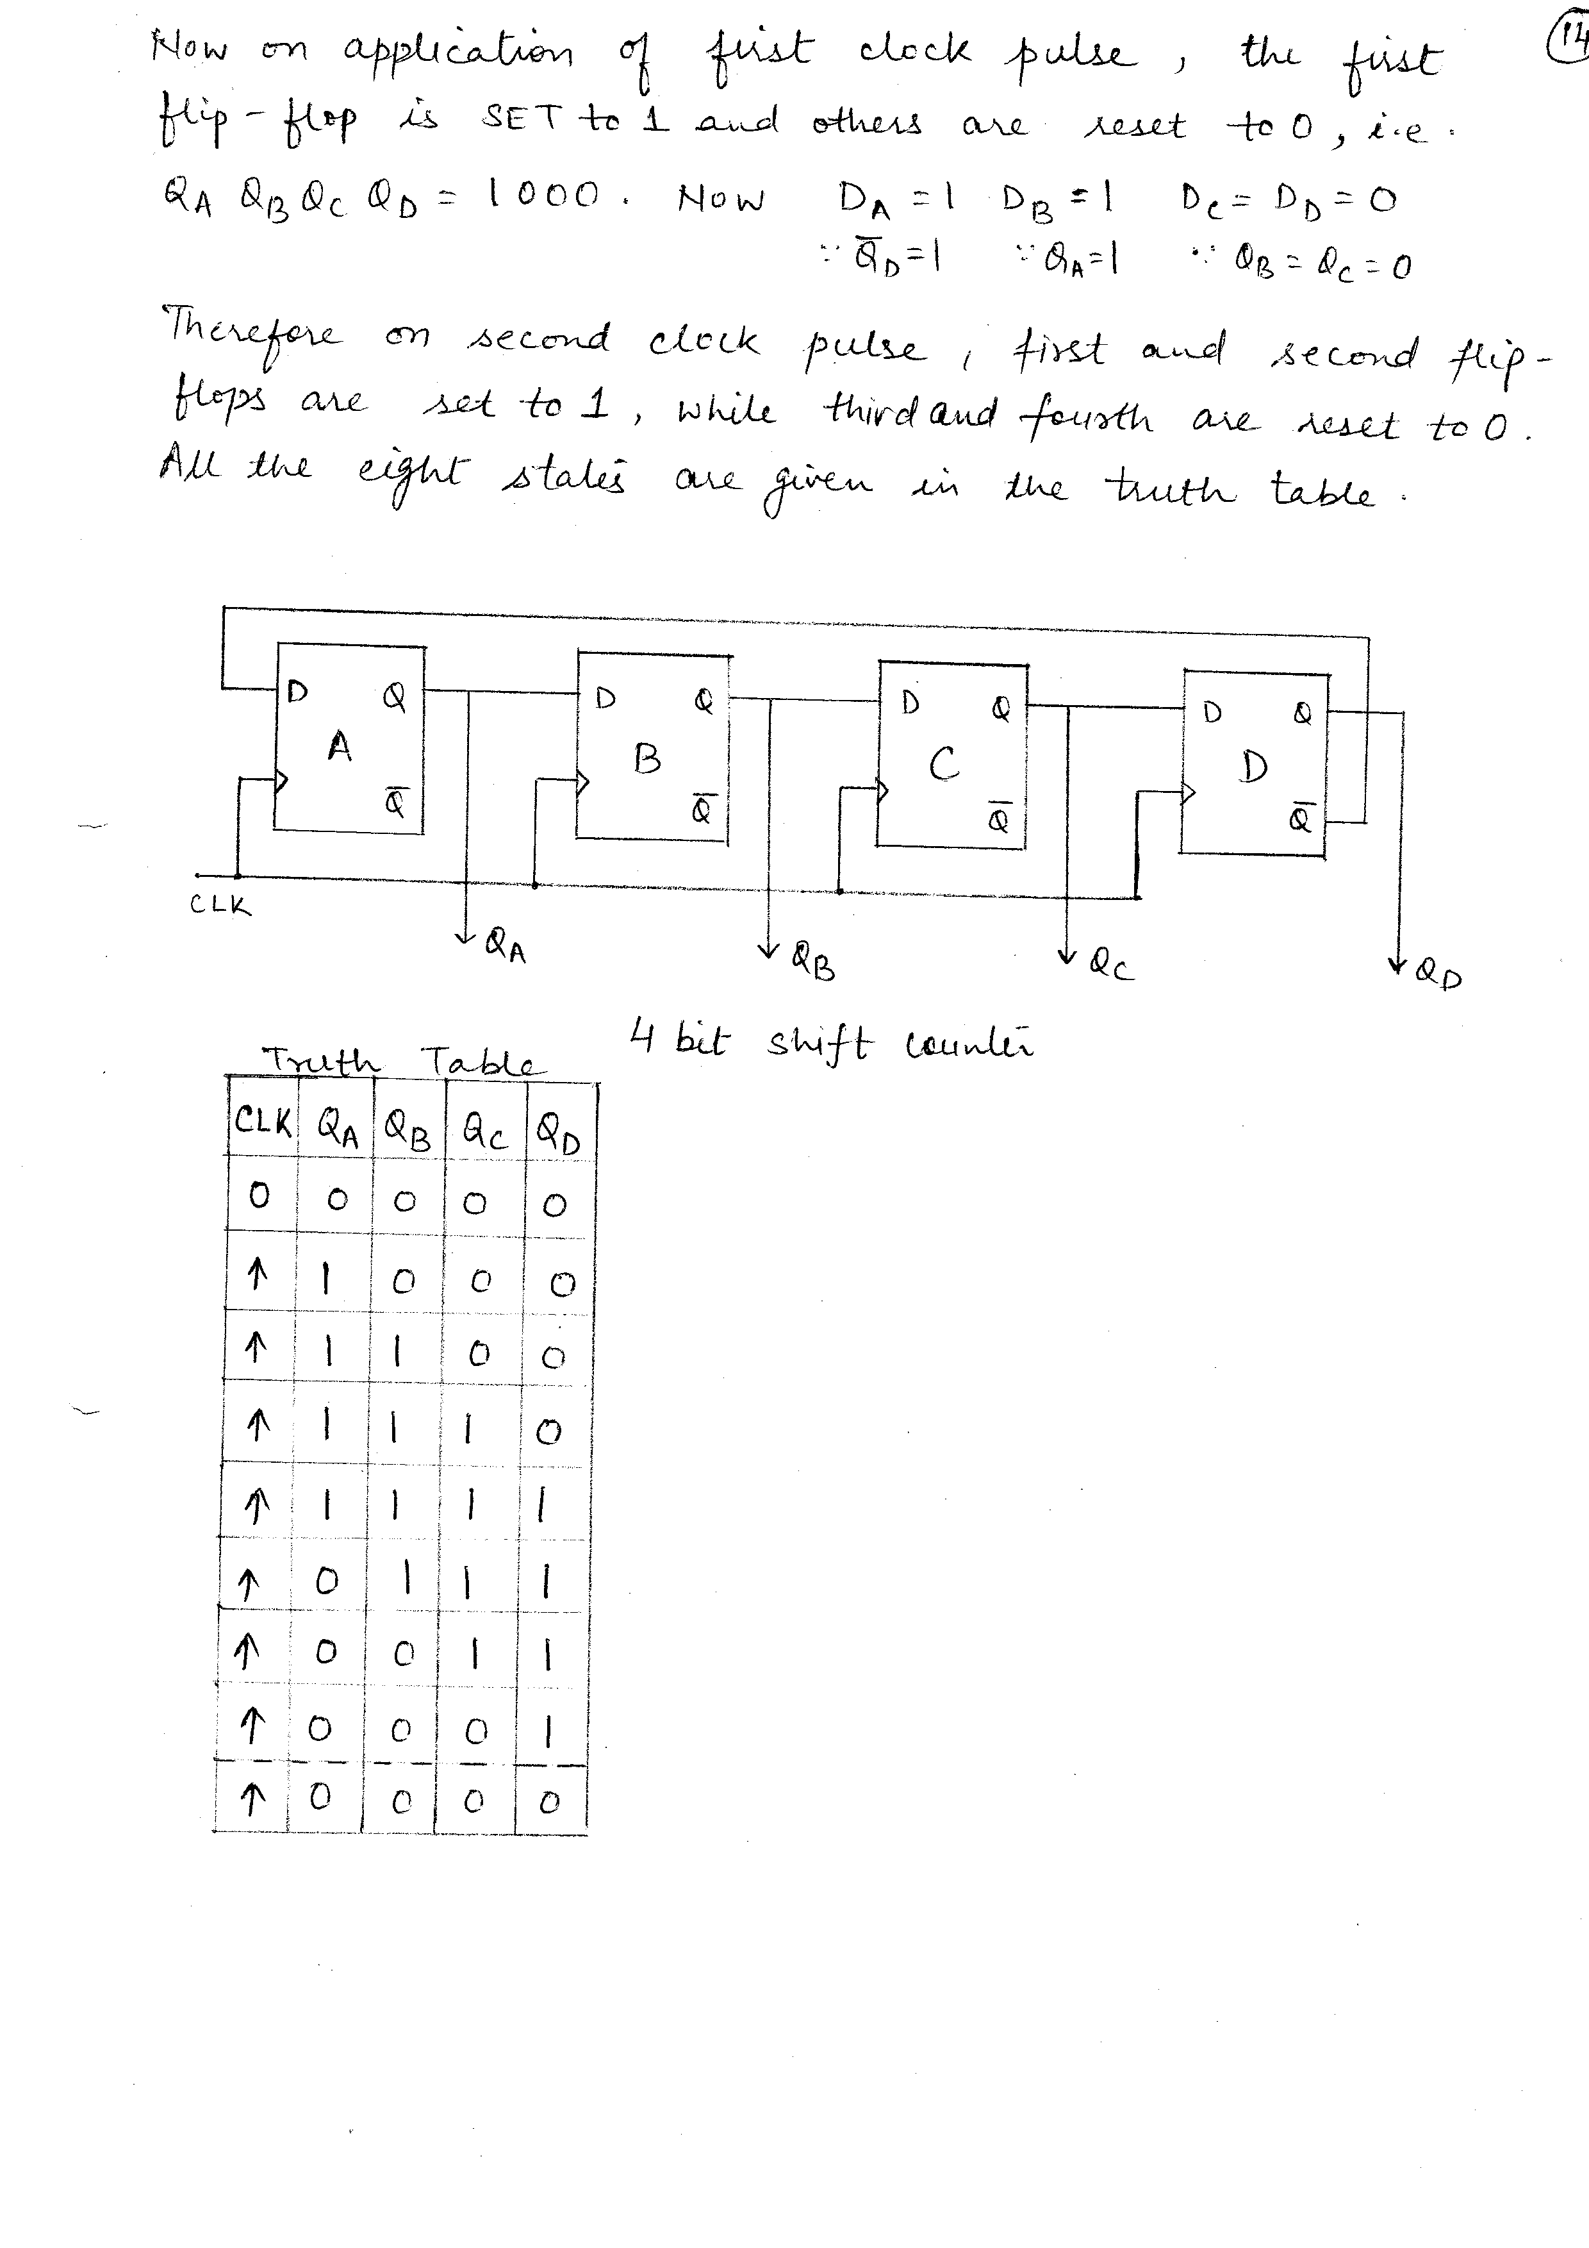
TWISTED RING COUNTER

Slide 37
TWISTED RING COUNTER
The inverted output Q_{D}’ is connected to the D input of first flip-flop A; for other flip-flops outputs of each flip-flop is connected to next stage D input.
Initially the counter is reset to 0.
Now on application of first clock pulse, the first flip-flop is SET to 1 and others are reset to 0.
On second clock pulse, first and second flip-flop are set to 1 while the third and fourth are reset to 0.

Slide 38
TRUTH TABLE

Slide 39
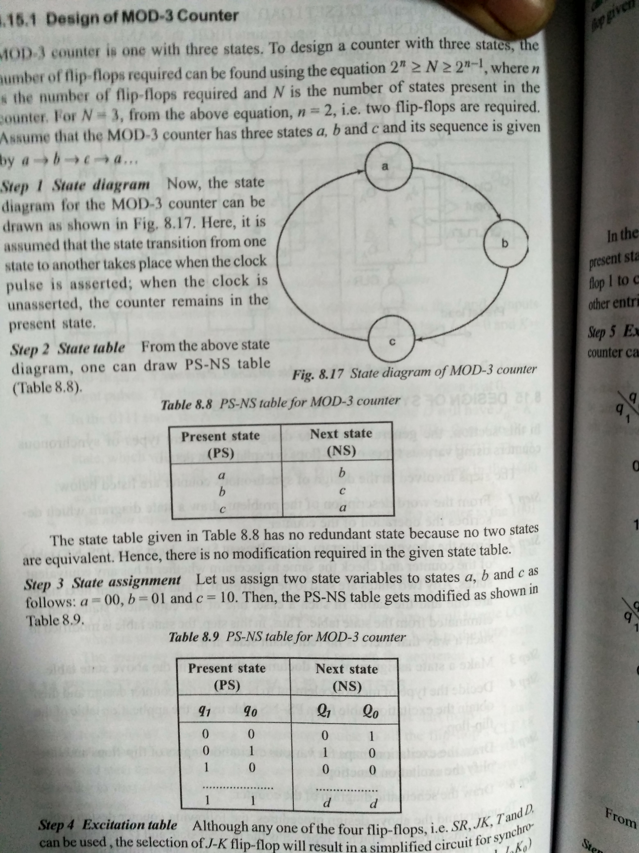
DESIGN OF MOD-3 COUNTER
Step 1: Draw state diagram

Slide 40
DESIGN OF MOD-3 COUNTER
Step 2: Draw state table

Slide 41
DESIGN OF MOD-3 COUNTER
Step 3: Draw the state assignment table.

Slide 42
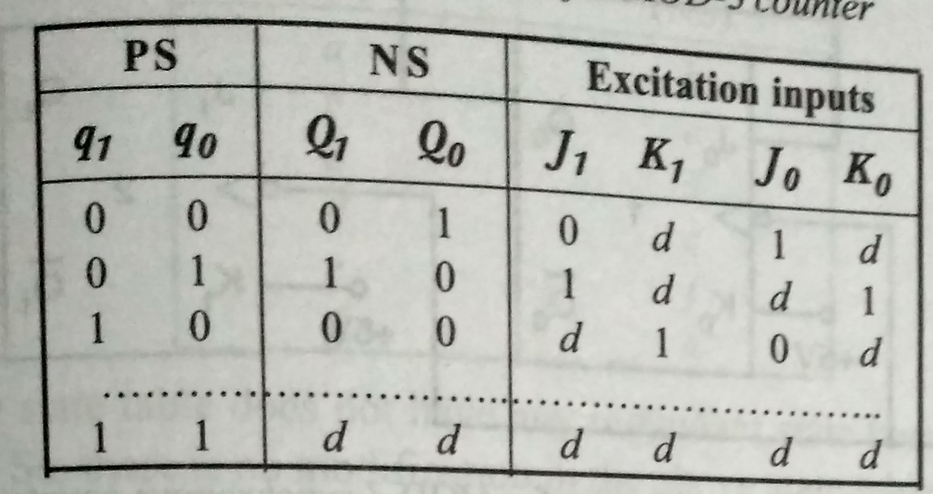
DESIGN OF MOD-3 COUNTER
Step 4: Draw the excitation table.

Slide 43
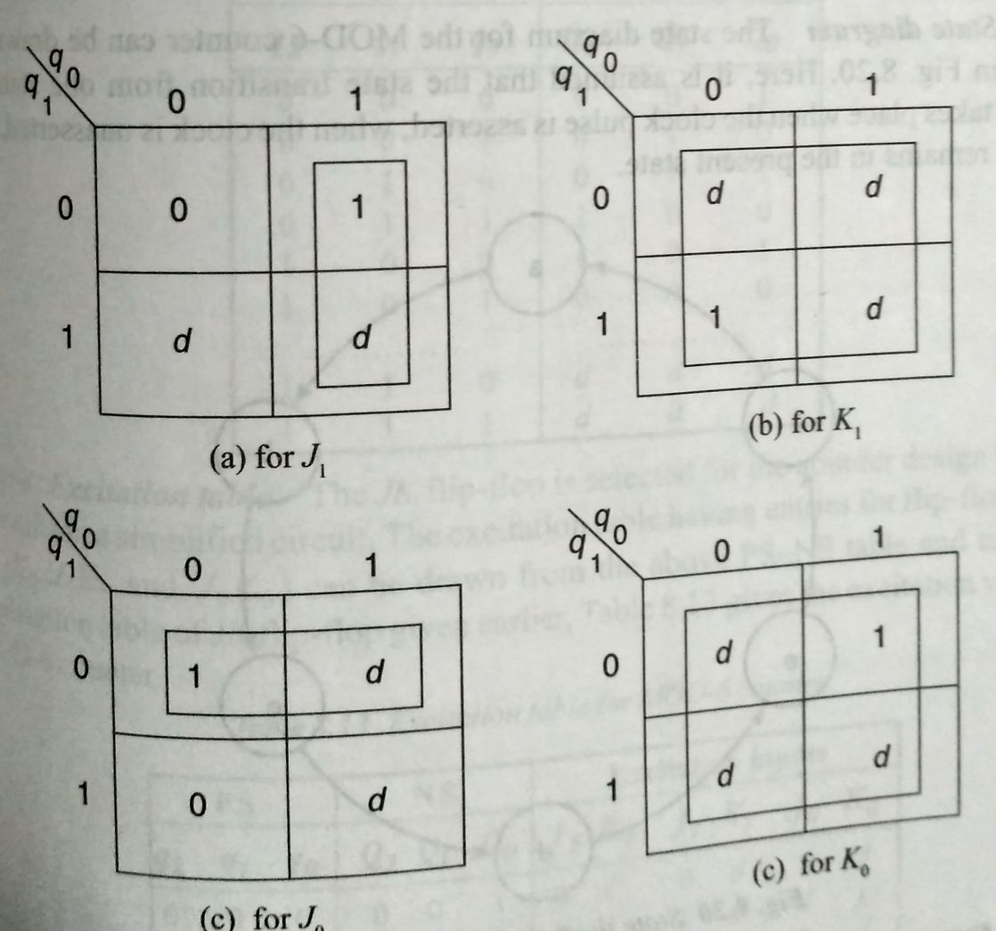
DESIGN OF MOD-3 COUNTER
Step 5: Draw the excitation maps.

Slide 44
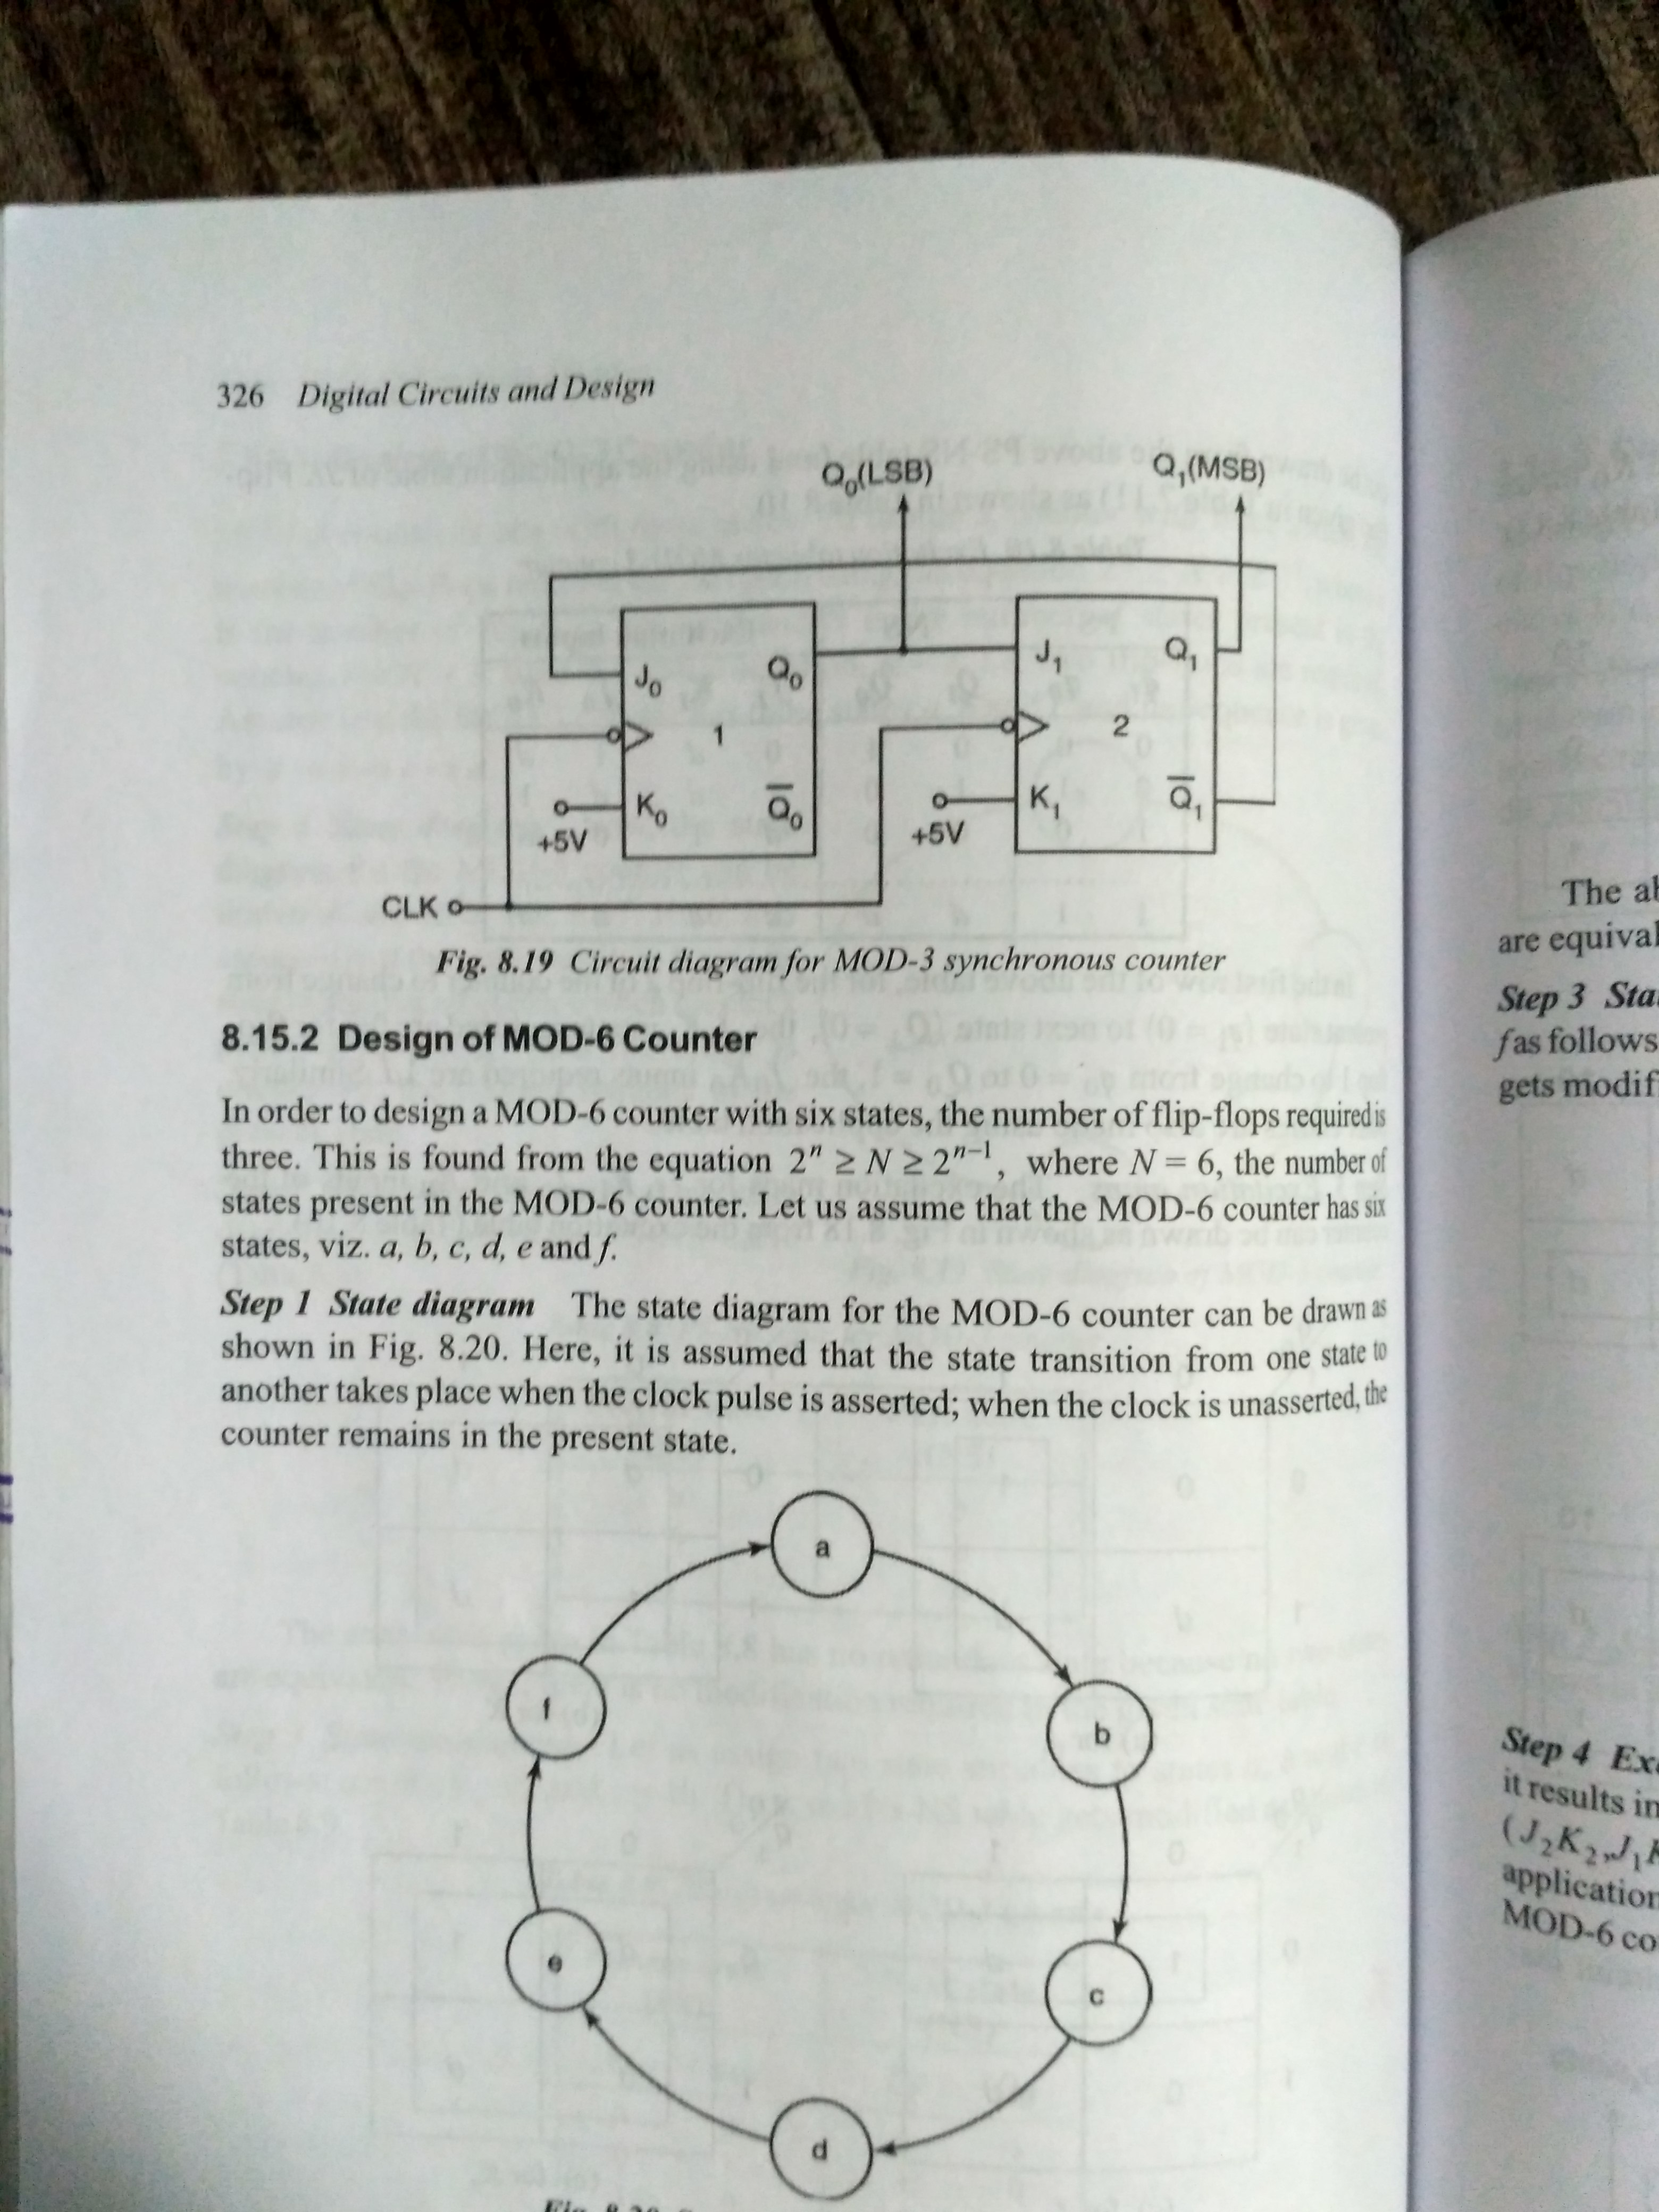
DESIGN OF MOD-3 COUNTER
Step 6: Draw the circuit diagram.

Slide 45
DESIGN OF MOD-6 COUNTER
Step 1: Draw state diagram

Slide 46
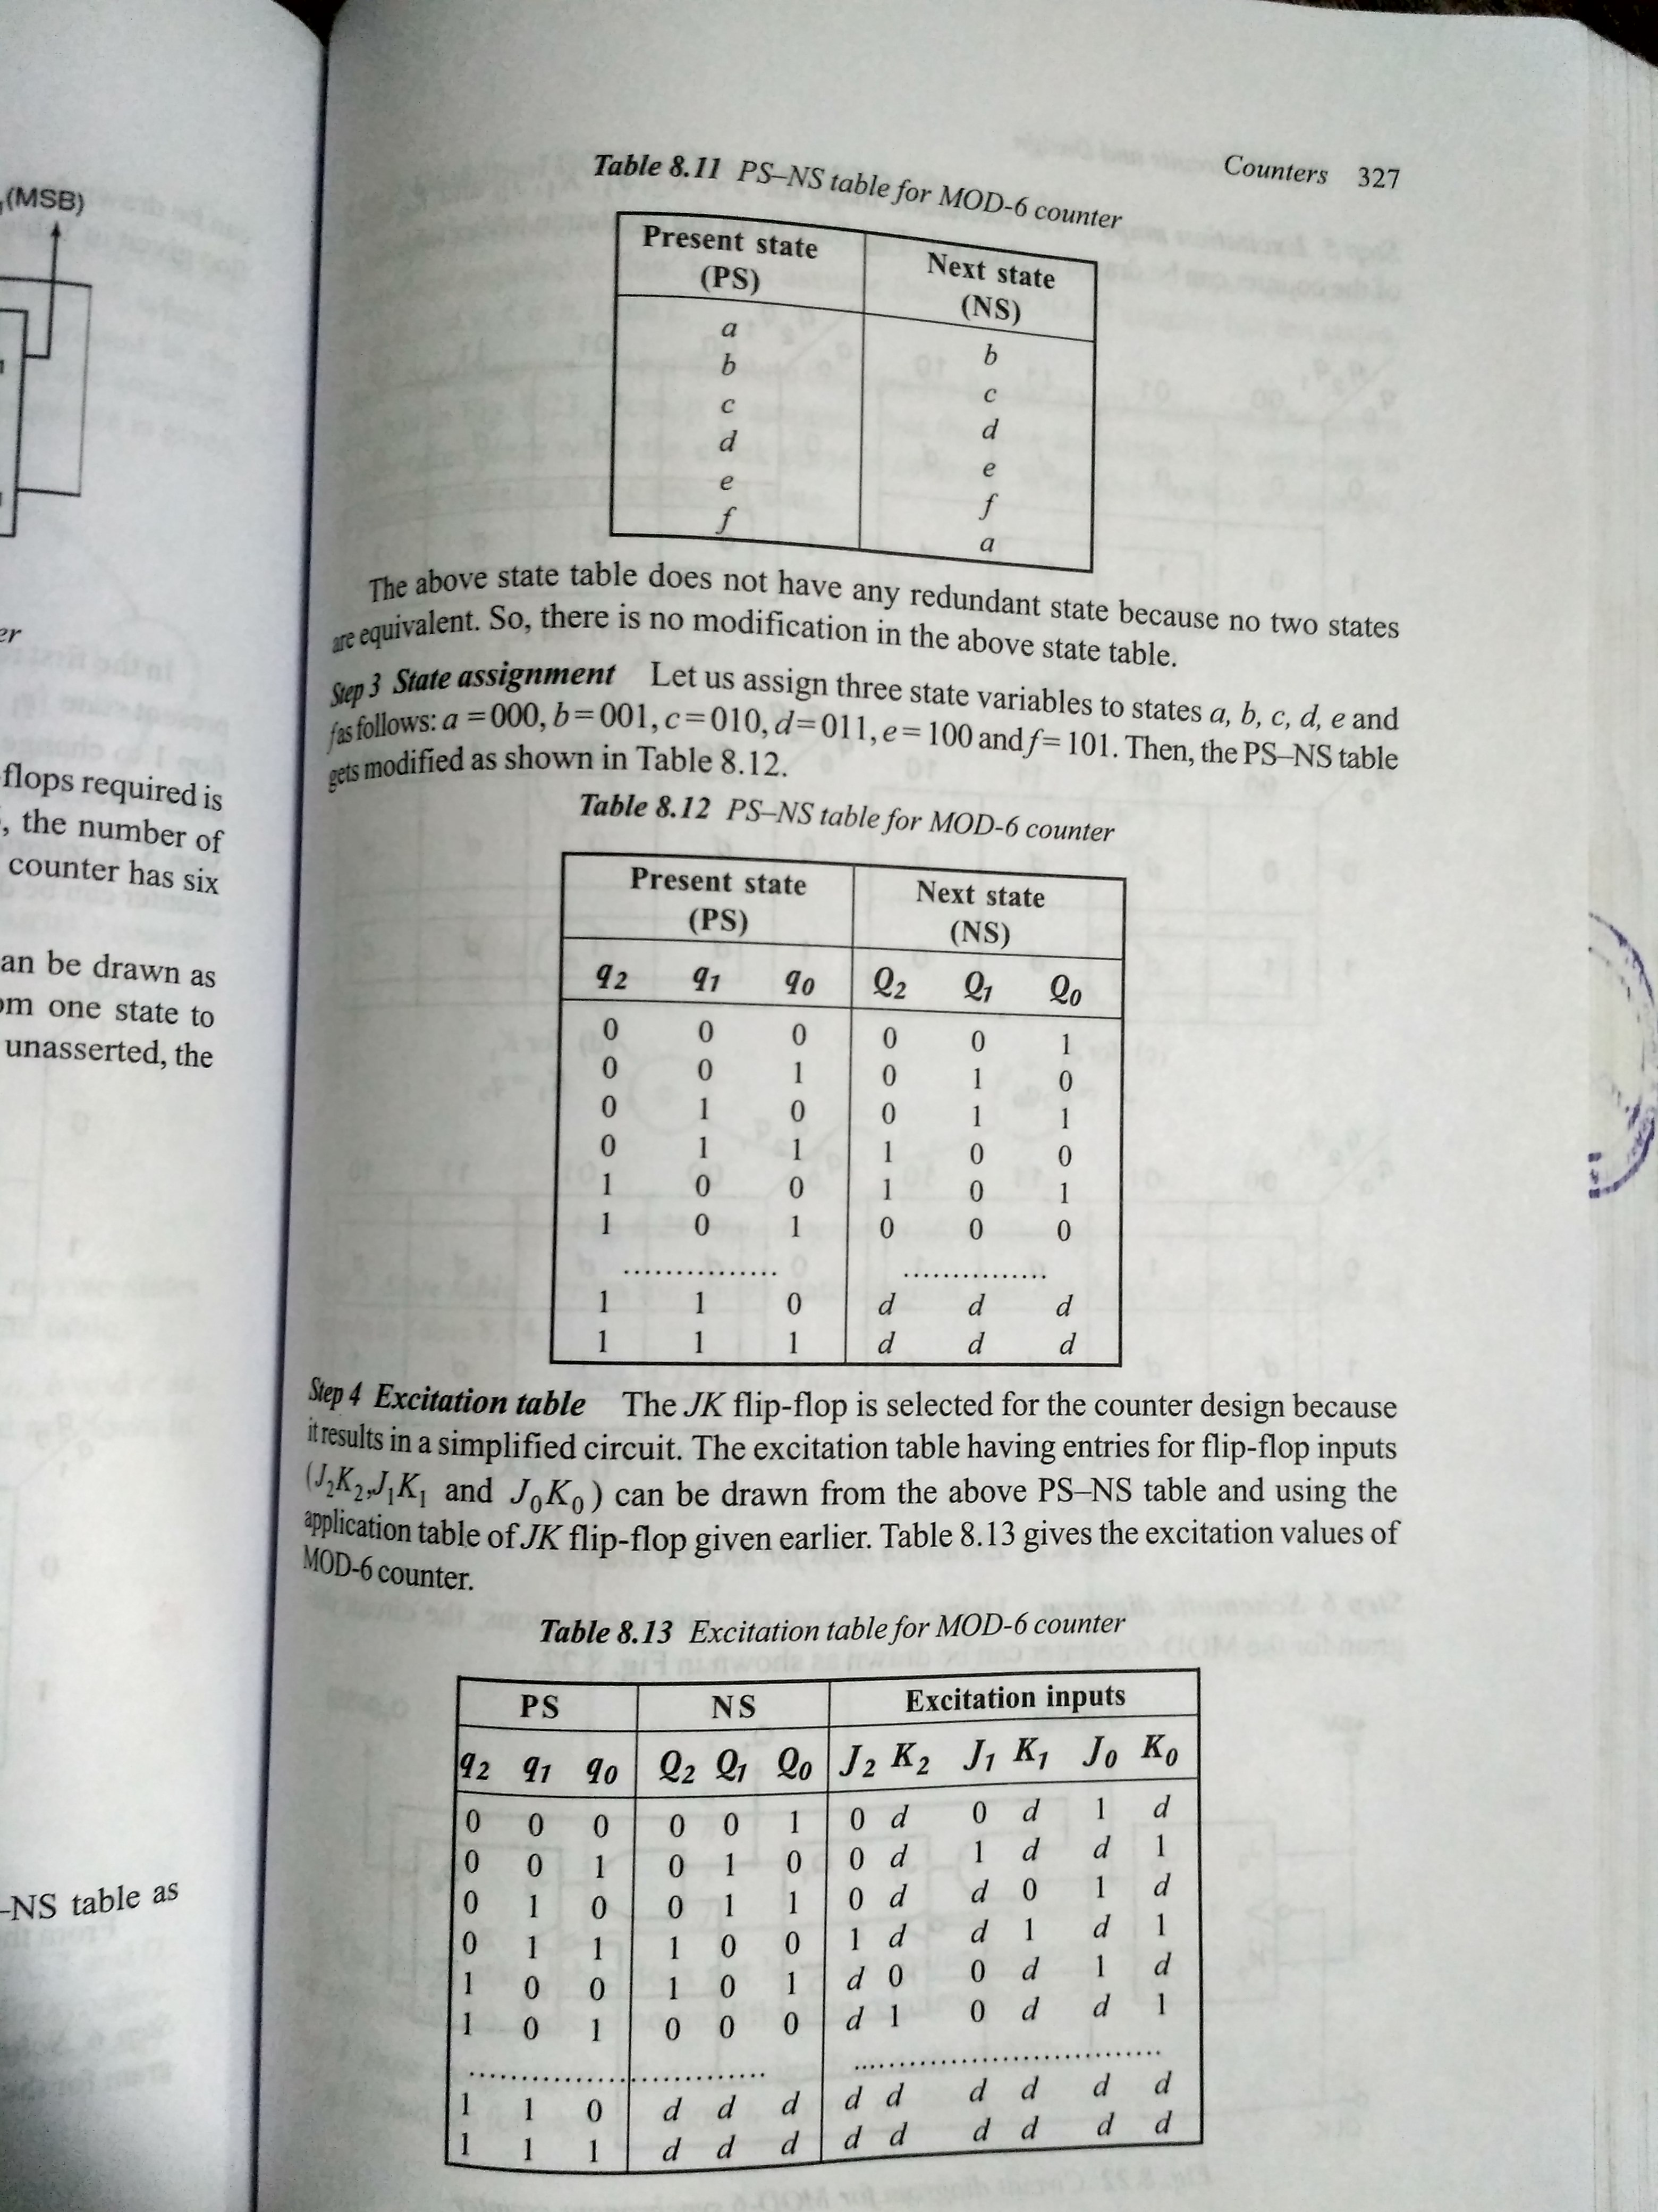
DESIGN OF MOD-6 COUNTER
Step 2: Draw state table

Slide 47
DESIGN OF MOD-6 COUNTER
Step 3: Draw the state assignment table.

Slide 48
DESIGN OF MOD-6 COUNTER
Step 4: Draw the excitation table.

Slide 49
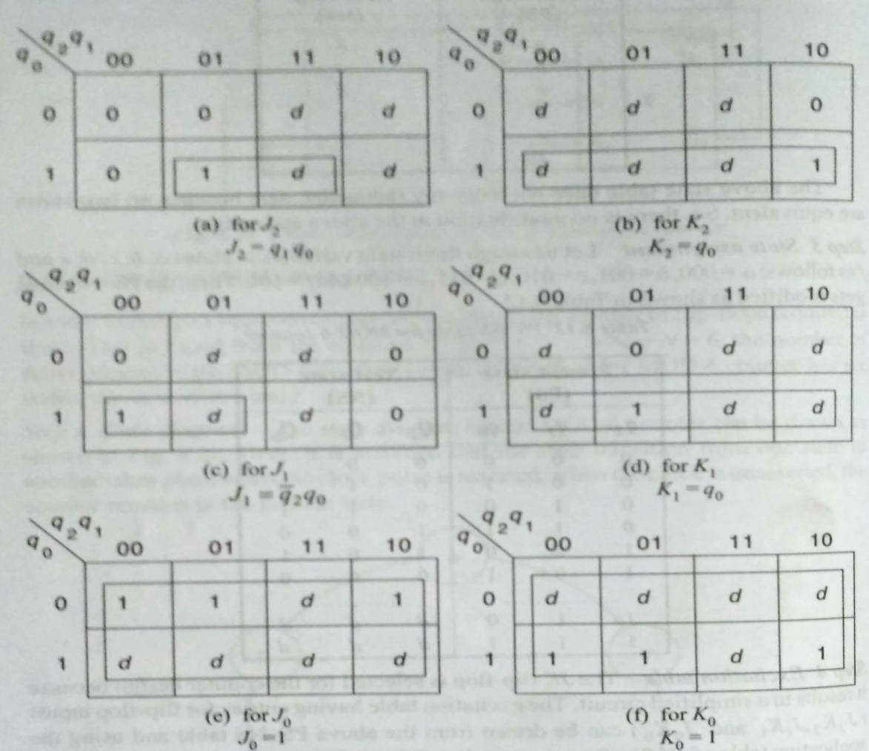
DESIGN OF MOD-6 COUNTER
Step 5: Draw the excitation maps.

Slide 50

DESIGN OF MOD-6 COUNTER
Step 6: Draw the circuit diagram.

Slide 51
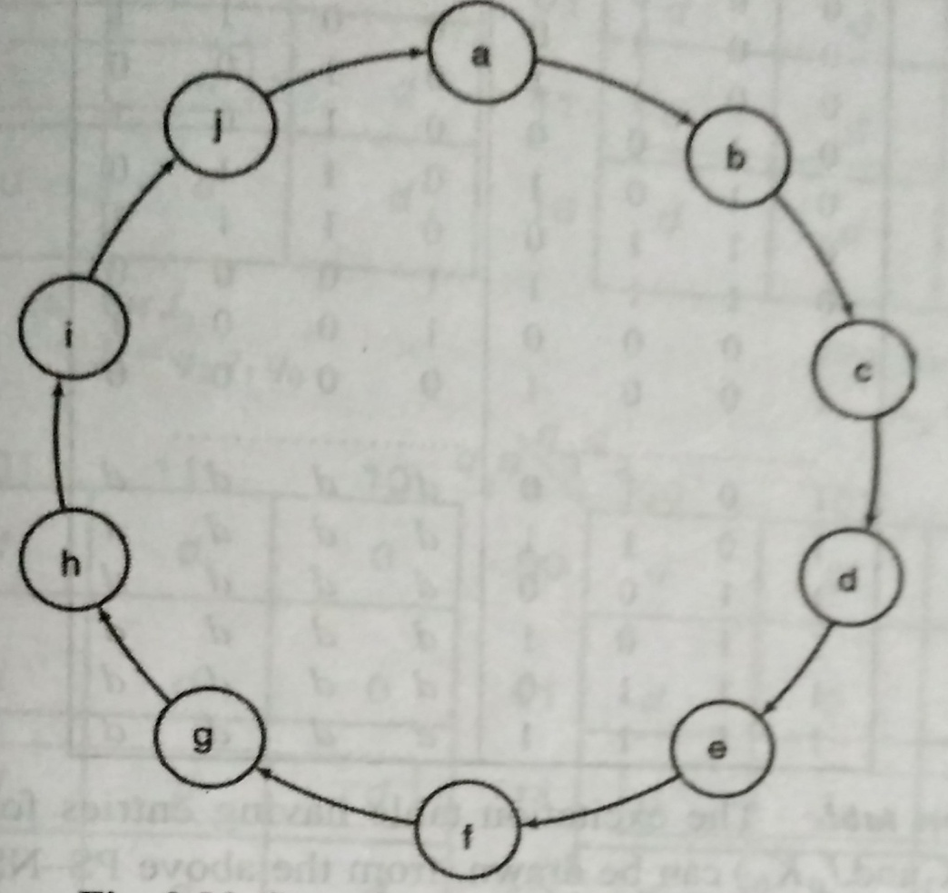
DESIGN OF BCD or DECADE or MOD-10 COUNTER
Step 1: Draw state diagram

Slide 52
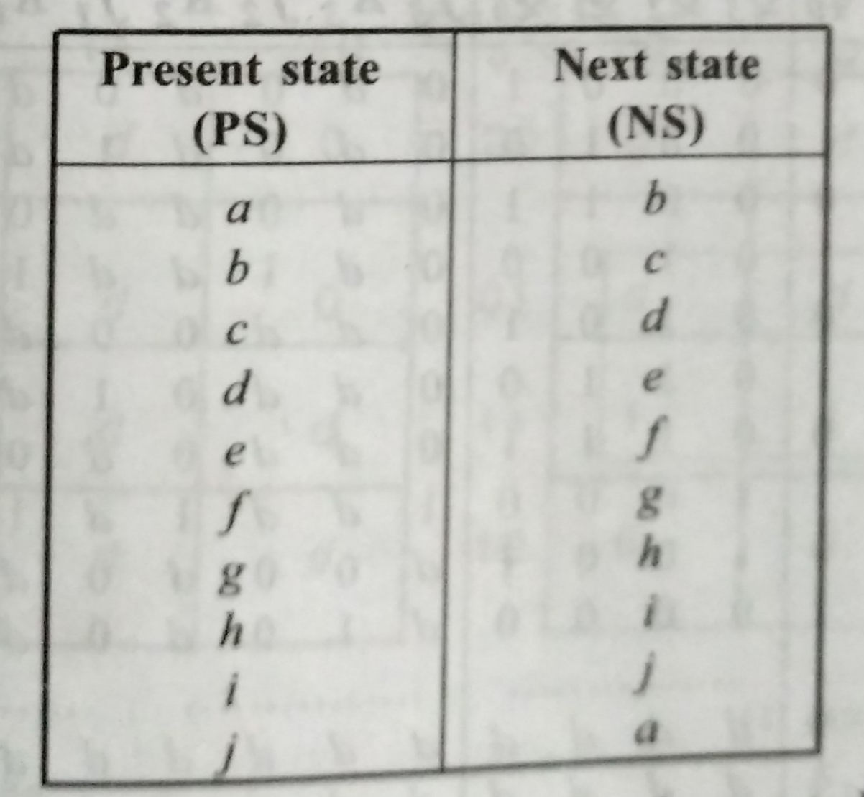
DESIGN OF BCD or DECADE or MOD-10 COUNTER
Step 2: Draw state table.

Slide 53
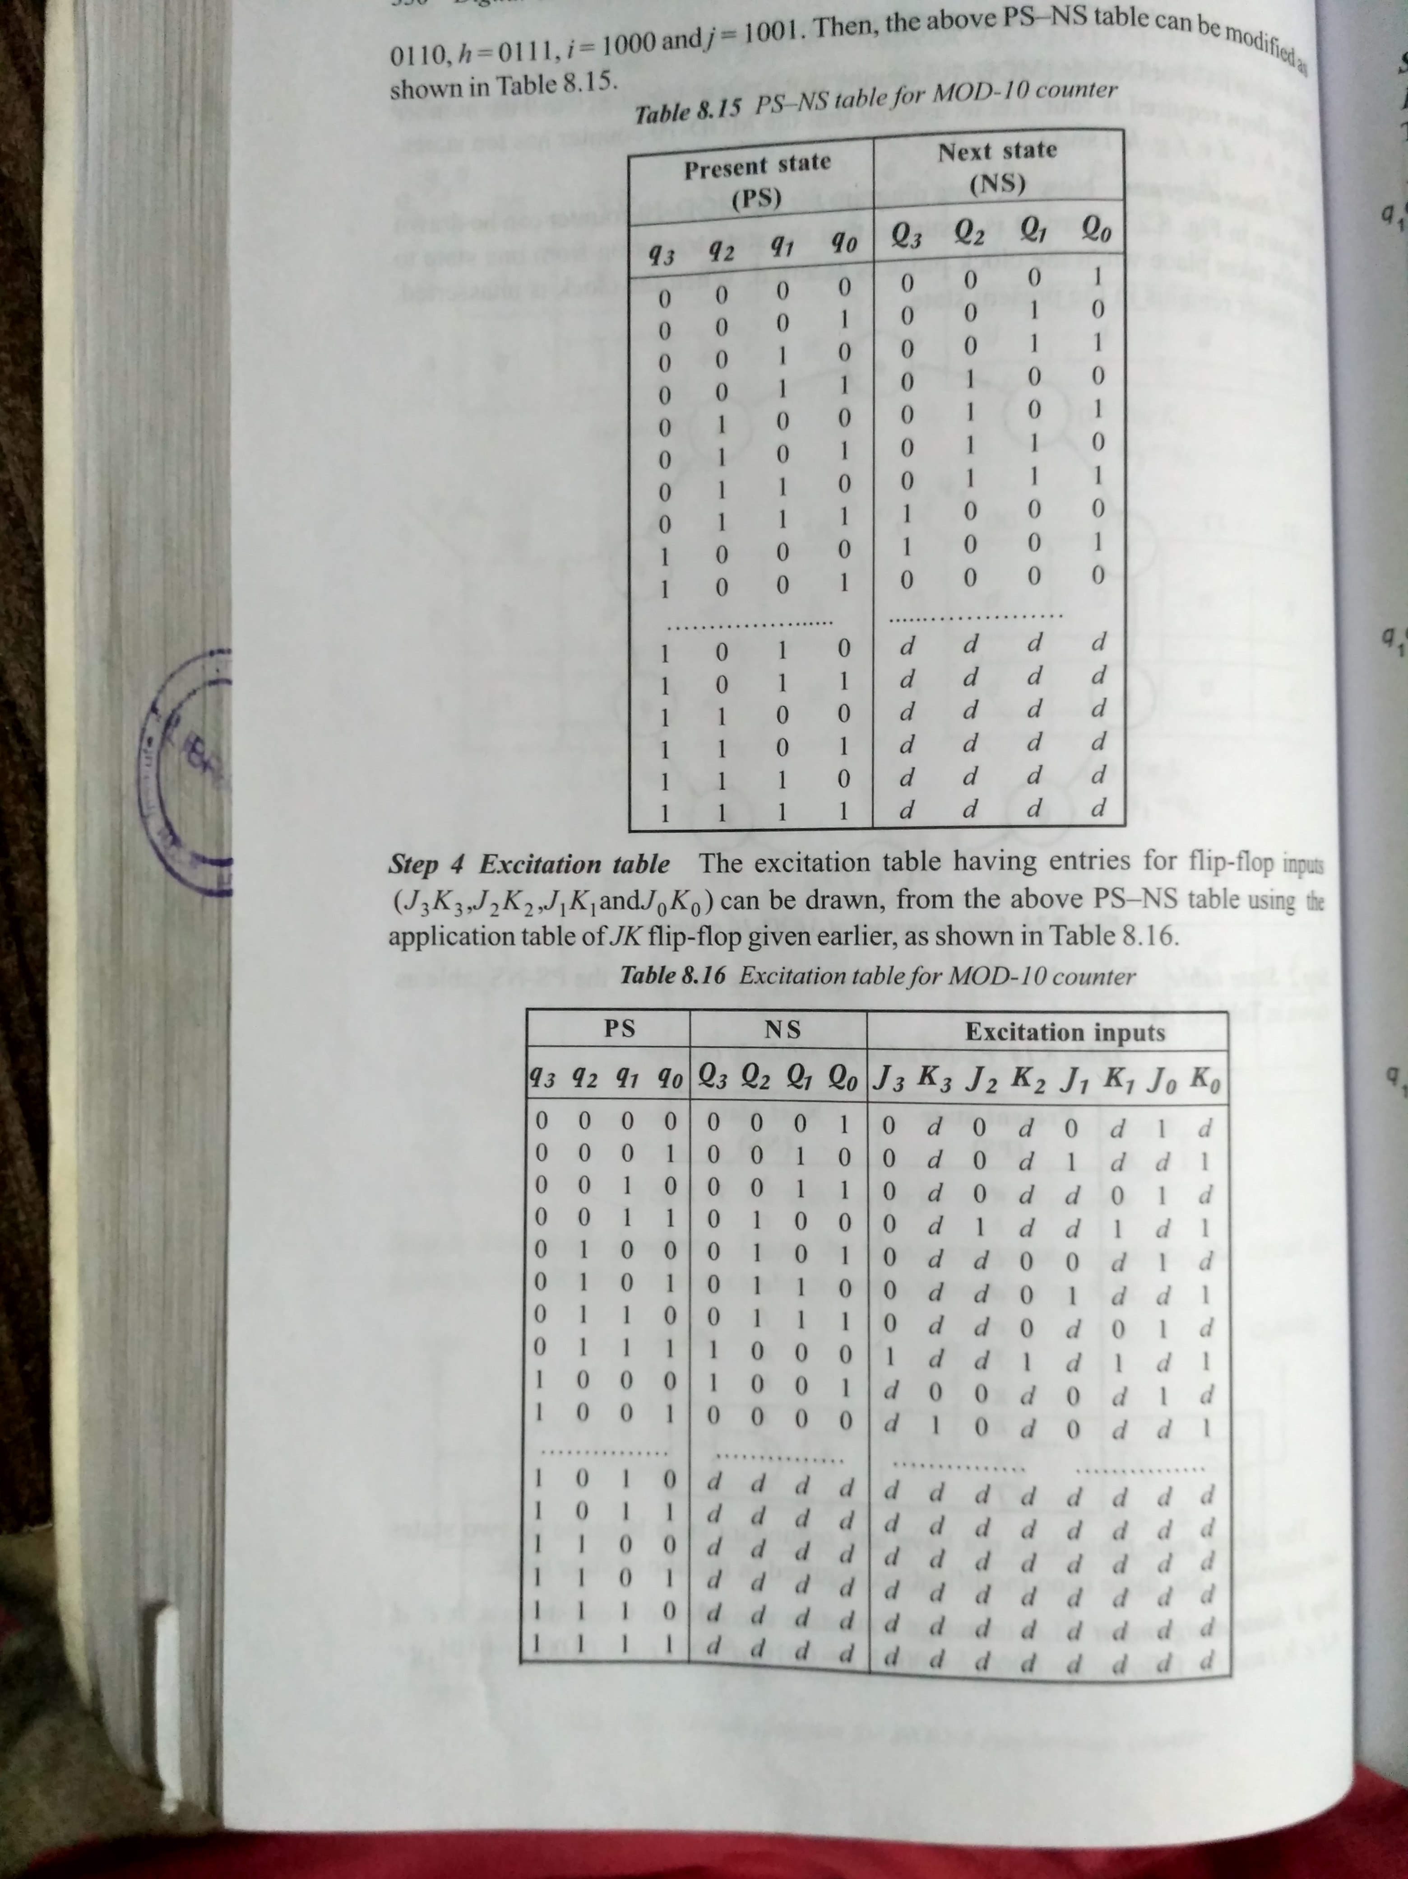
DESIGN OF BCD or DECADE or MOD-10 COUNTER
Step 3: Draw the state assignment table.

Slide 54
DESIGN OF BCD or DECADE or MOD-10 COUNTER
Step 4: Draw the excitation table.

Slide 55
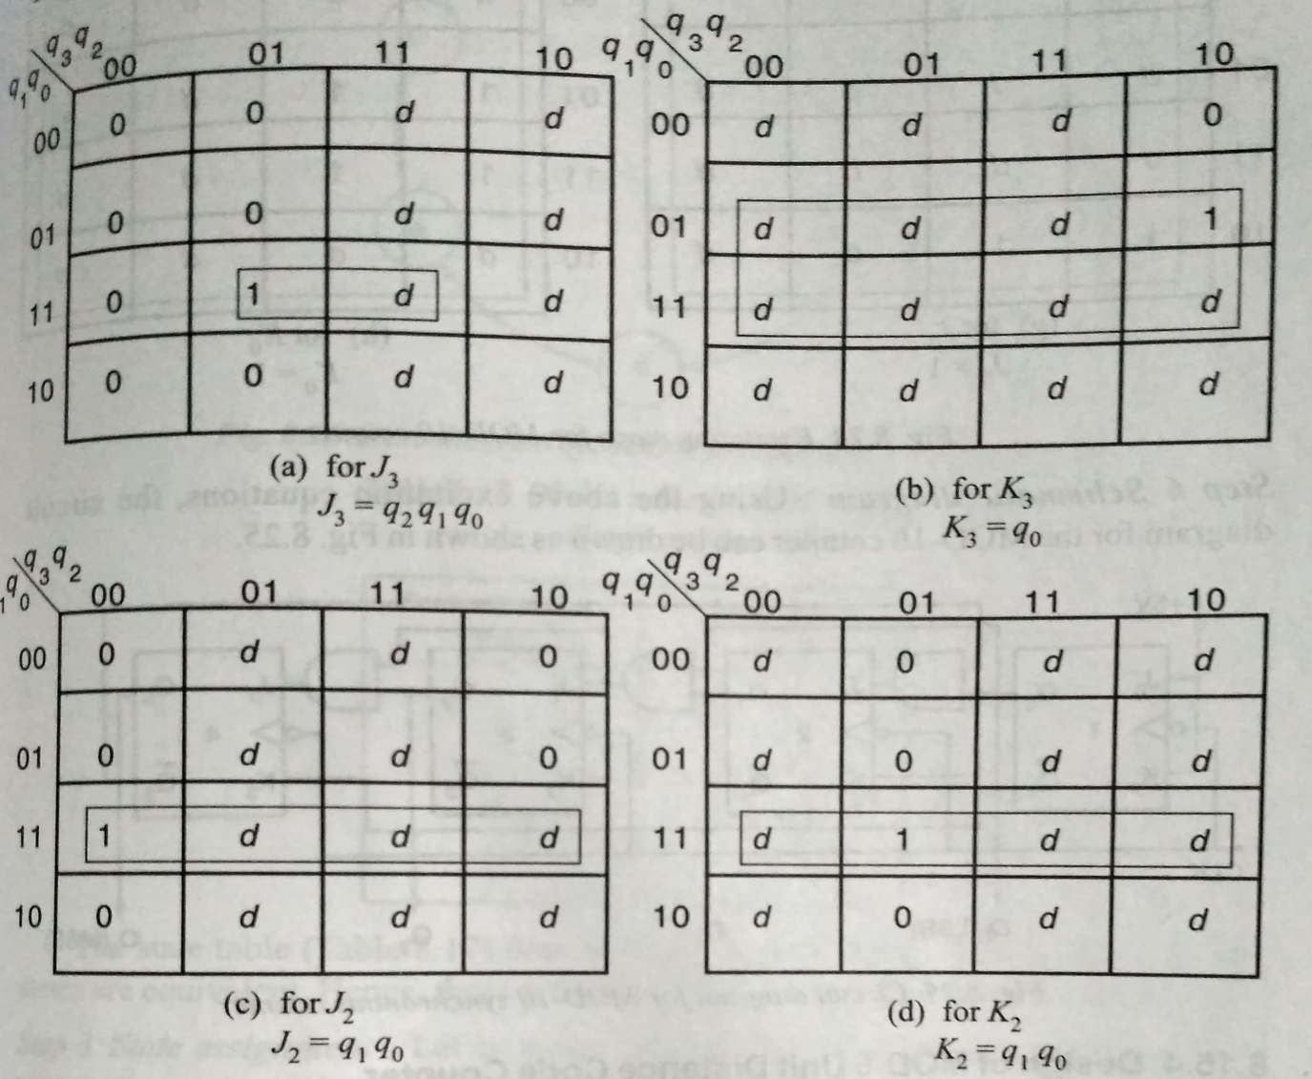
DESIGN OF BCD or DECADE or MOD-10 COUNTER
Step 5: Draw the excitation maps.

Slide 56

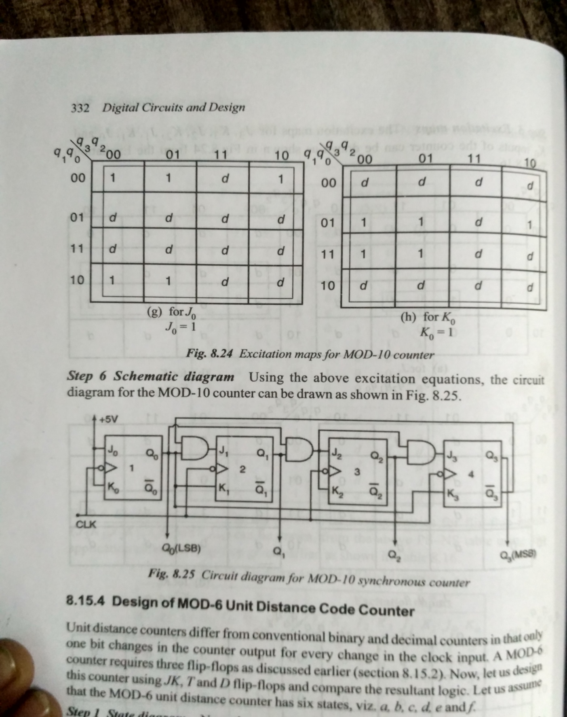
DESIGN OF BCD or DECADE or MOD-10 COUNTER
Step 5: Draw the excitation maps.

Slide 57

DESIGN OF BCD or DECADE or MOD-10 COUNTER
Step 6: Draw the circuit diagram.

Slide 58
MEMORY DEVICES
Memory is an indispensible part of computer and microprocessor based systems.
The data used in a program as well as the instructions for executing the program are stored in the memory.
Hence digital systems require memory facilities for temporary storage as well as permanent storage of data to perform the function.

Slide 59
BASIC MEMORY STRUCTURE
A memory unit is a collection of storage cells with associated circuits needed to transfer information in and out of the device.
It stores data or binary information in groups of bits called words.
Each word consists of a sequence of 0s and 1s.
Each word stored in memory location is represented by an address.
The communication between a memory and its environment is achieved through data input/output lines, address selection lines and control lines that specify the direction of transfer.

Slide 60
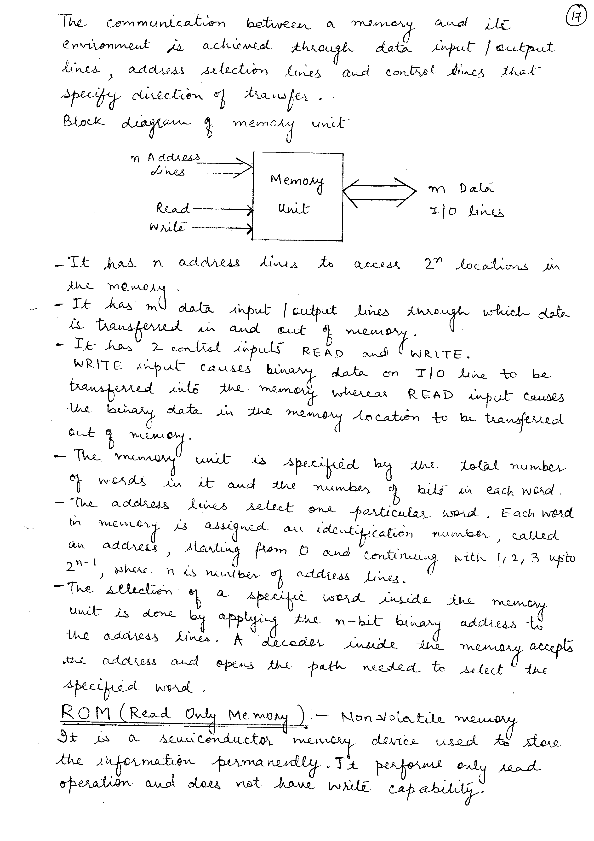
BASIC MEMORY STRUCTURE

Slide 61
BASIC MEMORY STRUCTURE
It has n address lines to access 2^{n} locations in the memory.
It has m data input/output lines through which data is transferred in and out of memory.
It has two control inputs READ and WRITE.
WRITE input causes binary data on I/O line to be transferred into the memory whereas READ input causes the binary data in the memory location to be transferred out of memory.
The memory unit is specified by the total number of words in it and the number of bits in each word.

Slide 62
ROM (READ ONLY MEMORY)
It is a semiconductor memory device used to store the information permanently.
It performs only read operation and does not have write capability.
ROM is a combinational circuit and includes both the decoder and OR gate within a single IC package.
In order to minimize the number of address lines, decoders are used.

Slide 63
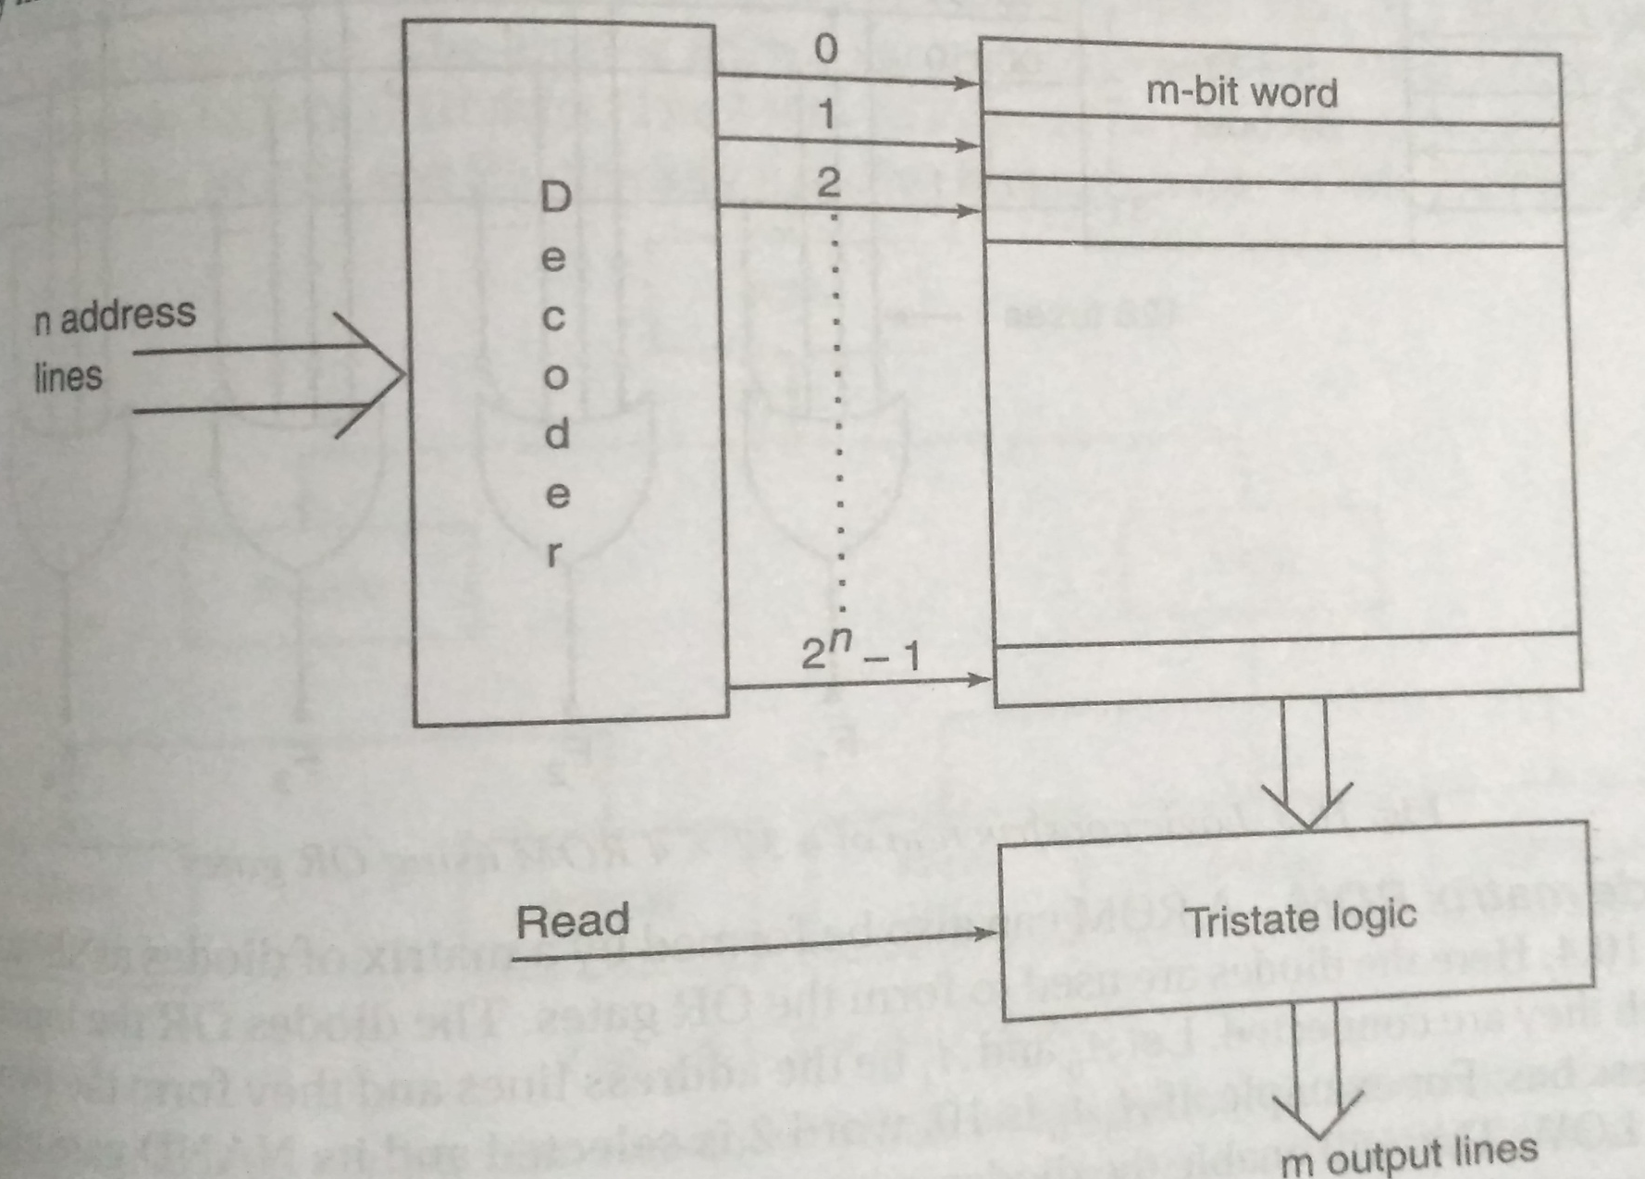
ROM ARCHIECTURE

Slide 64
ROM ARCHITECTURE
It consists of n address lines and m output lines.
Each bit combination of the address variables is called an address.
Each bit combination that comes out of the output lines is called a data word.
The word available on the output lines at any instant depends on the address value applied to the input lines.

Slide 65
32 X 4 ROM USING OR GATES
It consists of 32 words of 4 bits each.
This means that there are 4 output lines and there are 32 distinct words stored in the unit.
There are 5 address lines in a 32X4 ROM.
Internally the ROM is a combinational circuit with AND gates connected as decoders, and the number of OR gates is equal to the number of output lines.

Slide 66
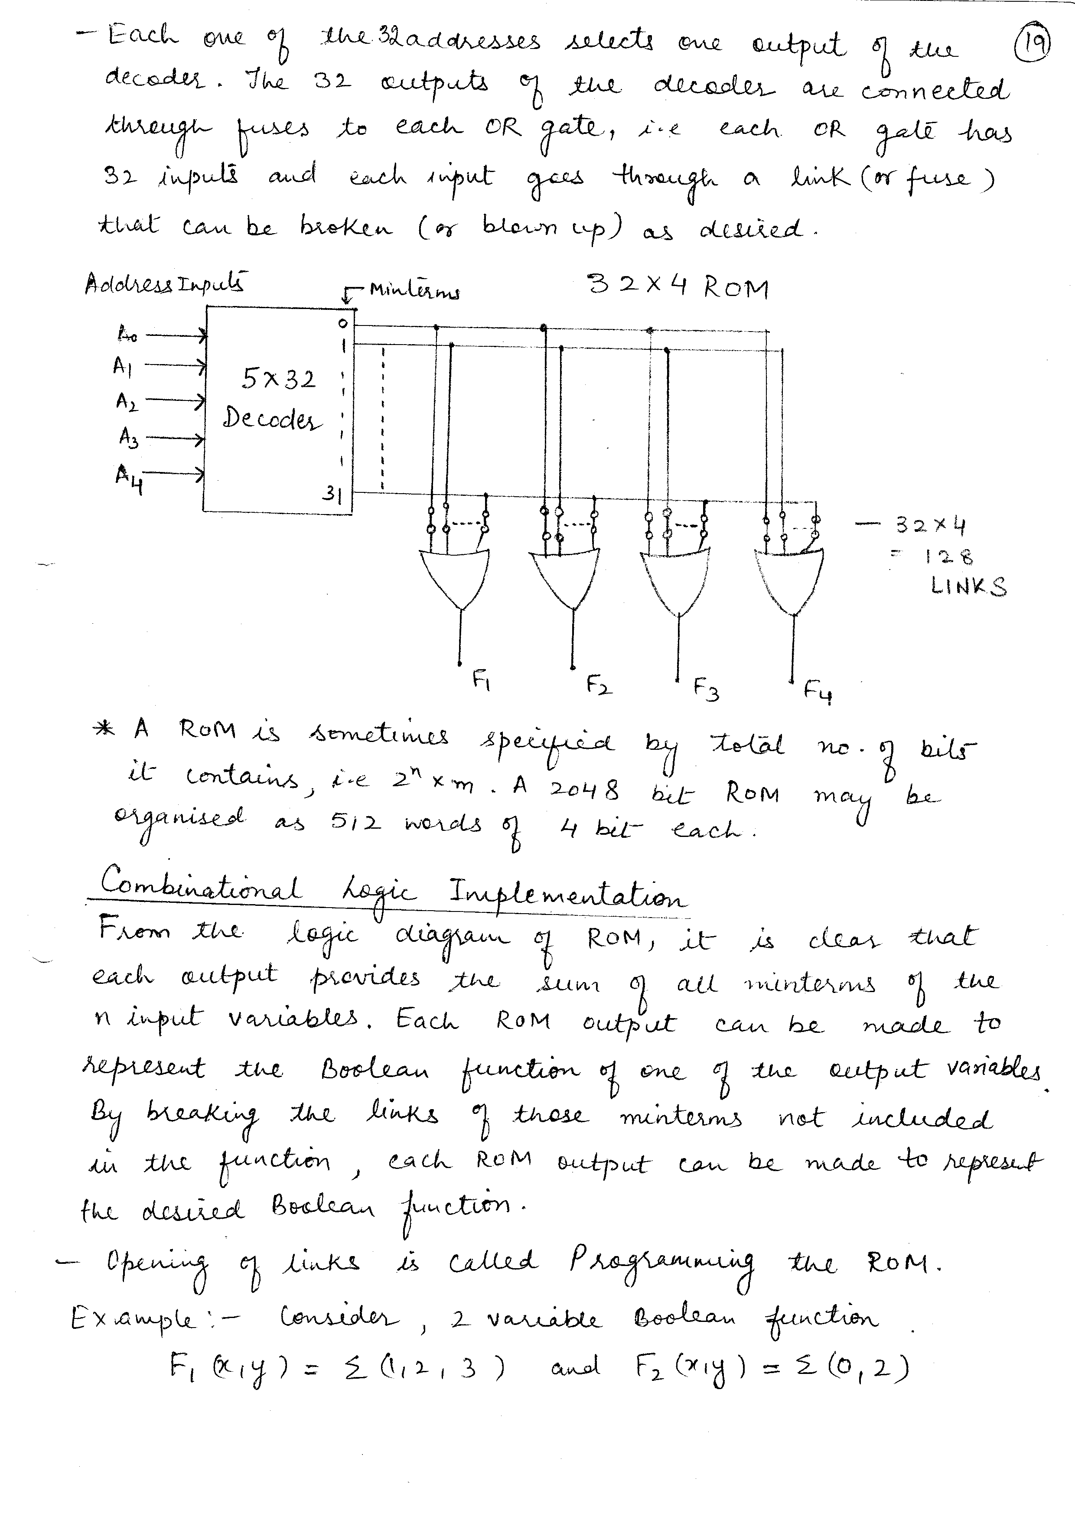
32 X 4 ROM USING OR GATES

Slide 67
DIODE MATRIX ROM
A ROM can also be formed by a matrix of diodes.
Here the diodes are used to form the OR gates.

Slide 68
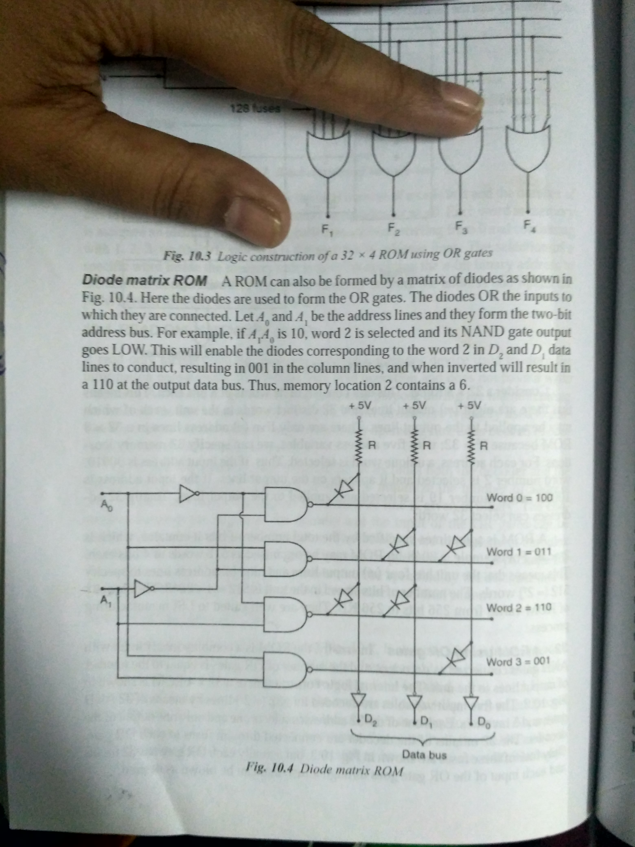
DIODE MATRIX ROM

Slide 69
TYPES OF ROM
Types of ROM
Bipolar
Mask ROM
PROM
MOS
Mask ROM
PROM
EEPROM

Slide 70
TYPES OF ROM
Semiconductor ROMs are manufactured with bipolar technology or with MOS technology.
ROMs can be classified into several types which differ as to how information is written or programmed into the memory storage locations.
Bipolar ROMs use bipolar transistor within an integrated circuit much in the same way as the diode matrix.
The bipolar ROMs can be programmed.
MOS ROM is constructed using MOSFETs.

Slide 71
MASK ROM
Mask ROM is permanently programmed during the manufacturing process.
It is actually programmed by the manufacturer according to the customer’s applications.
Once the memory is programmed, it cannot be changed.
The major disadvantage of this type of ROM is that it cannot be reprogrammed in the event of a design change requiring a modification of the stored program.

Slide 72
PROM (PROGRAMMABLE ROM)
The PROM can be programmed electrically by the user but cannot be reprogrammed.
In a PROM chip, the manufacturer includes a connection at every intersection of the grid of address and data lines.
PROMs are widely used in the control of electrical equipment such as washing machines and electric ovens.

Slide 73
EPROM (ERASABLE PROGRAMMABLE ROM)
A PROM device that can be erased and reprogrammed is called Erasable PROM (EPROM).
It uses an array of n-channel enhancement type MOSFET’s with an insulated gate structure.
The main disadvantage of EPROM is that the entire memory should be erased before reprogramming.

Slide 74
RAM (RANDOM ACCESS MEMORY)
It is a volatile chip memory in which both read and write operations can be performed.
Any random location can be accessed for information transfer to or from the memory.
It is also called Read-Write Memory (RWM).

Slide 75
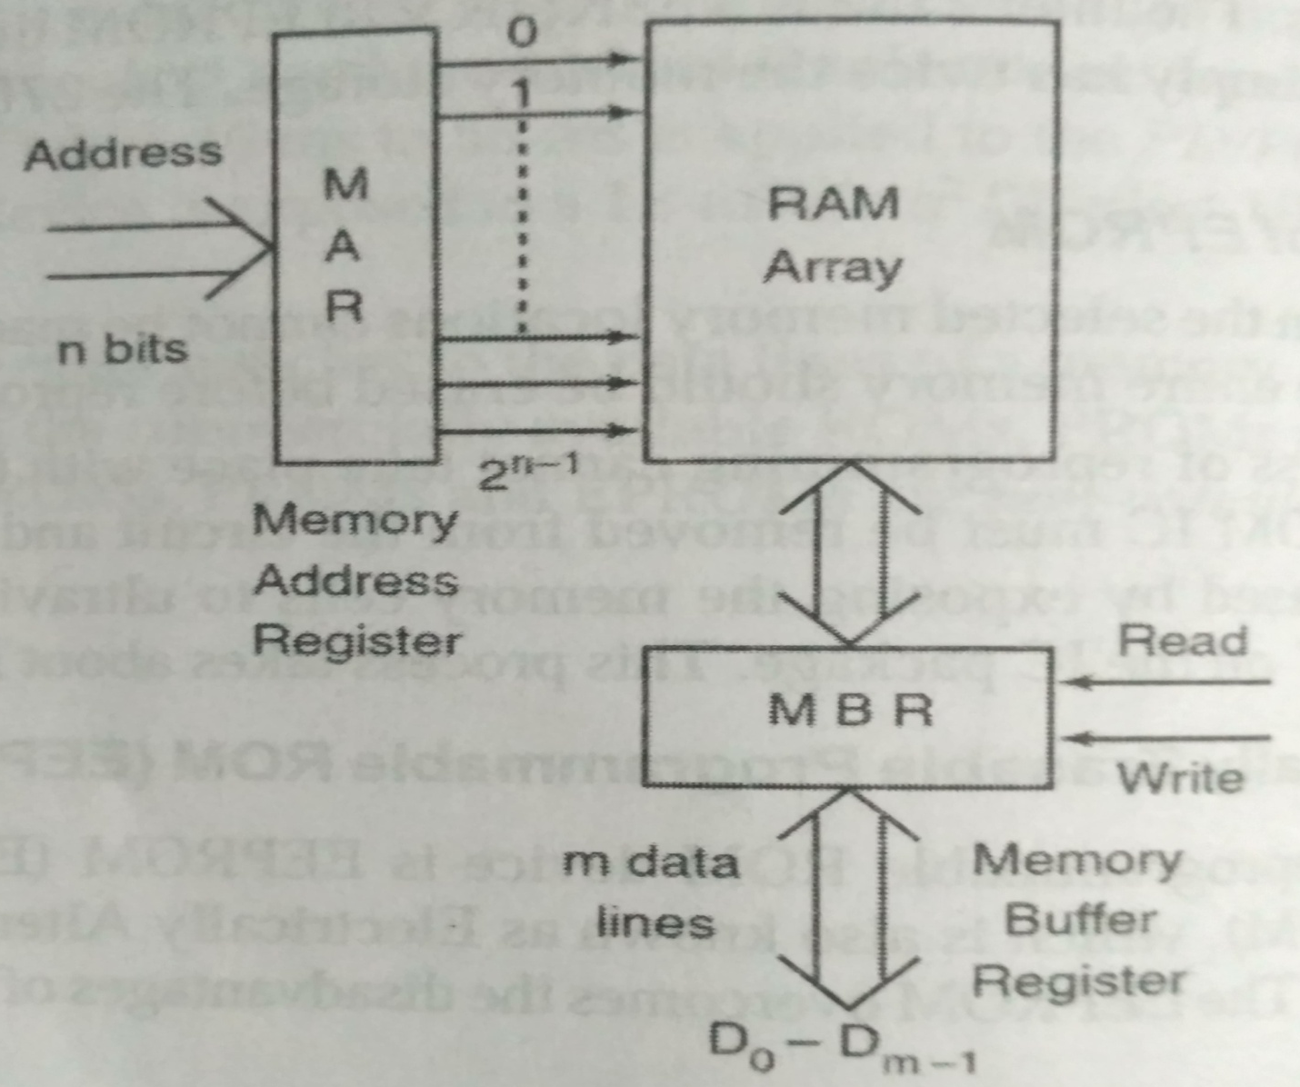
RAM (RANDOM ACCESS MEMORY)

Slide 76
RAM (RANDOM ACCESS MEMORY)
It has n address lines to access 2n memory locations and m data lines to read/write data from/to memory.
The n-bit address is placed in Memory Address Register (MAR) to select 2n memory locations.
Read and Write control signals that are used to enable memory for read and write operations.

Slide 77
TYPES OF RAM
Types of RAM
Bipolar
Static RAM
MOS
Static RAM
Dynamic RAM

Slide 78
STATIC RAM
A static RAM contains an array of flip-flops, one for each stored bit.
Data written into a flip-flop remains stored as long as DC power is maintained.
The memory capacity of a static RAM varies from 64 bits to 1 Mega bit.

Slide 79
DYNAMIC RAM
It is the lowest cost, highest density RAM available.
Nowadays, computers use DRAM for main memory storage with the memory sizes ranging from 16 to 256 mega bytes.
DRAM stores its binary information in the form of electric charges on capacitors.
These memory devices makes use of an integrated MOS capacitor as basic memory cell instead of a flip-flop.

Slide 80
DIFFERENCE BETWEEN STATIC AND DYNAMIC RAM
BASIS | SRAM | DRAM
Speed | Faster | Slower
Size | Small | Large
Cost | Expensive | Cheap
Used in | Cache Memory | Main Memory
Construction | Complex and uses transistors and latches | Simple and uses capacitors and few transistors
Power Consumption | Low | High
Single Block of Memory Requires | 6 Transistors | 1 Transistor

Slide 81
PROGRAMMABLE LOGIC ARRAY (PLA)
It is a type of fixed architecture logic devices with programmable AND gates followed by programmable OR gates.
It is used to implement a complex combinational circuit.
In VLSI design, PLAs are used because the area required by the regular AND and OR arrays is less than the area required by the randomly interconnected gates.
Several PLAs include storage elements such as flip-flops on the silicon chip, so that they can be used for sequential applications.

Slide 82
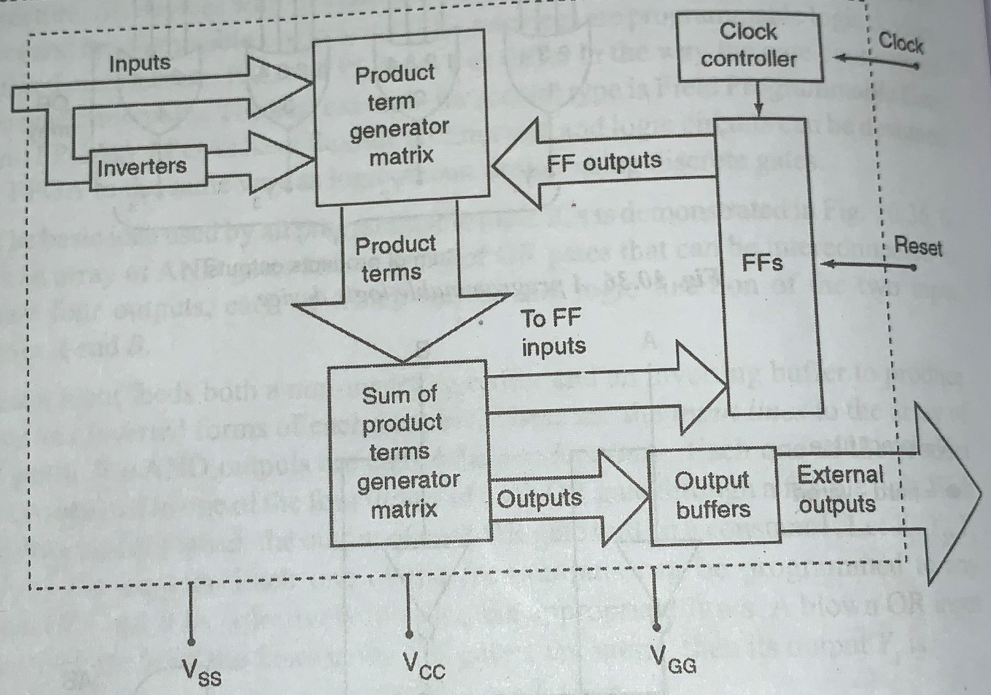
PROGRAMMABLE LOGIC ARRAY (PLA)

Slide 83
PROGRAMMABLE ARRAY LOGIC (PAL)
It is also a type of fixed architecture logic devices with programmable AND gates followed by programmable OR gates.
Because only the AND gates are programmable, it is easier to program but it is not as flexible as PLA.
In PAL, the inputs to the AND gates are programmable, while the inputs of the Or gate are hard-wired.
This means that every AND gate can generate desired product of input variables while OR gates are used to select the AND gate outputs.

Slide 84
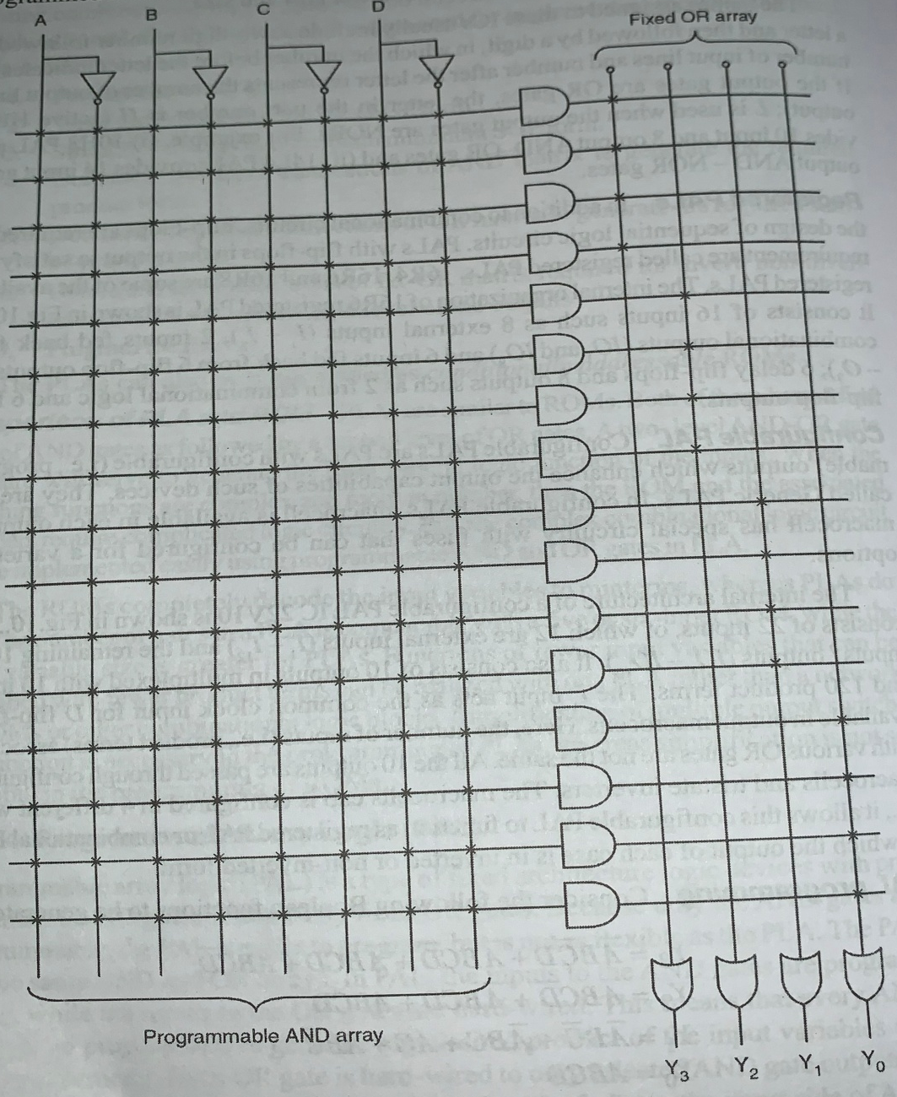
PROGRAMMABLE ARRAY LOGIC (PAL)

